Slide 1
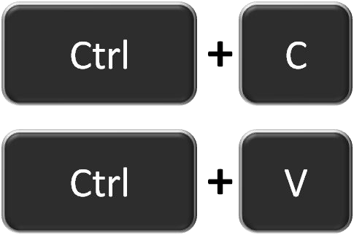

Who are you?
You are:
A copy/paste programmer of JavaScript, HTML, CSS
(or you've never used these languages)
A good programmer in at least one real* programming language
(Java, C++, etc)
Frustrated
(maybe)
*In case it's unclear, I'm being facetious

Slide 2
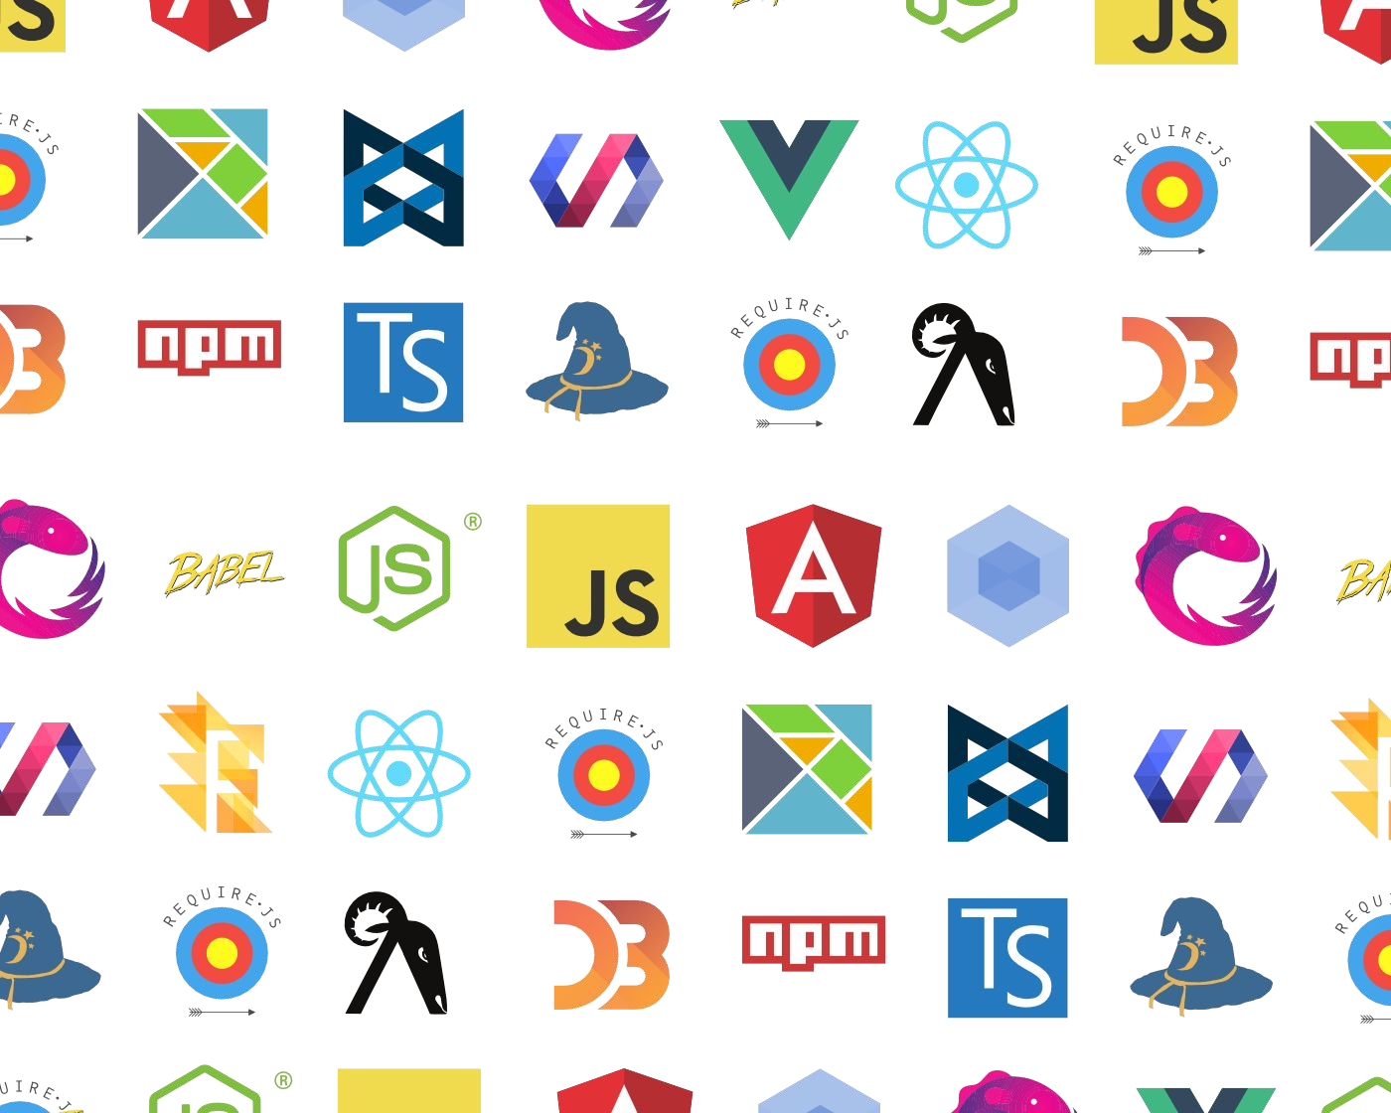
Frustrated?
You want to learn JavaScript...
...but you're overwhelmed by all the frameworks, libraries, tools, etc and have no idea where to start.

Slide 3
What is this course about?
Opinionated:
There are many ways to do things on the web: can't learn them all at once!
What I think you need to know as a beginner
Hopefully frustration-free:
We will go slowly through the essential concepts and speed through the obvious stuff
You are not expected to fill in the gaps via Google and StackOverflow

Slide 4
Goals
If you never take another web programming class again, you will leave this course with the following skills:
Create attractive, small scale web sites or apps that at least mostly work on phones
Have the vocabulary and background knowledge to understand technical writing/discussions about the web
(e.g. web API documentation; random blog posts)
Have the foundation to pursue the areas of web programming that you're interested in (if you choose)

Slide 5
Goals
If you never take another web programming class again, you will leave this course with the following skills:
Create attractive, small scale web sites or apps that at least mostly work on phones
Have the vocabulary and background knowledge to understand technical writing/discussions about the web
(e.g. web API documentation; random blog posts)
Have the foundation to pursue the areas of web programming that you're interested in (if you choose)

Slide 6
Section Info

Slide 7
Browser and Text editor/IDE
Text editor: You can use whatever you want. We recommend Visual studio code.
Browser: Your code must work on Chrome
- Code samples : We are using GitHub

Slide 8
CSS Section 1

Slide 9
Module 2 - CSS

Slide 10
Video 1 -Introduction

Slide 11
Earlier
We learnt about HTML and how to structure pages with it

Slide 12
How we can color elements or items
Or move items on screen
Or make beautiful animations

Slide 13
Welcome to the world of CSS

Slide 14
Pause

Slide 15
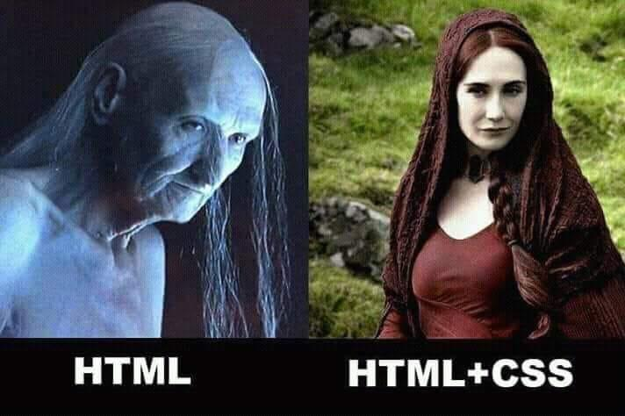
Meme from GOT

Slide 16
What to expect
In this section, we will cover
CSS Styles, rules and properties
How Bizarre HTML and CSS is
Selectors and Box Model
And Further explore questions around
- Why does invalid HTML/CSS still work sometimes
Why Not Use Divs and Spans everywhere
We will go slowly through the essential concepts and speed through the obvious stuff

Slide 17
Video 2 -Recap

Slide 18
That was weird
- We saw that HTML whitespace collapses into one space…
<h1>Web Dev is Fun</h1>
<strong>Announcements</strong><br/>
4/3: Homework 0 is out!<br/>
- Except weirdly the <h1> heading was on a line of its own, and <strong> was not.
Hmmm… strange…
Oh well, it works! Let's move on!!!

Slide 19
Recap Browsers! The Internet! The web!

Slide 20
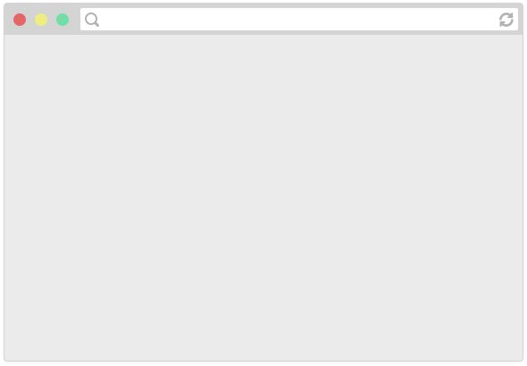
How do web pages work?
Browsers are applications that can display web pages.
E.g. Chrome, Firefox, Safari, Internet Explorer, Edge, etc.

Slide 21
How do web pages work?
These Web Browsers can display web pages

Slide 22
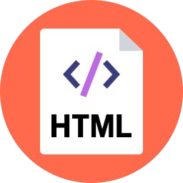
How do web pages work?
Web pages are written in a markup language called HTML, so browsers display a web page by reading and interpreting its HTML.

Slide 23
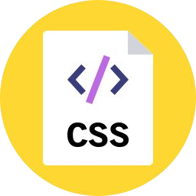
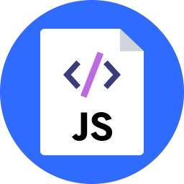

How do web pages work?
The HTML file might link to other resources, like images, videos, as well as JavaScript and CSS (stylesheet) files, which the browser then also loads.

Slide 24

How do web pages work?
A web server is a program running on a computer that delivers web pages in response to requests.
It either stores or generates the web page returned.

Slide 25
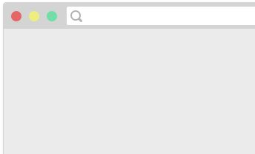
How do web pages work?
www.hiveacademy.co
1. You type in a URL,
which is the address of the HTML file on the internet.

Slide 26
How do web pages work?
2. The browser asks the web server that
hosts the document to send that document.
GET

Slide 27
How do web pages work?
3. The web server responds to the
browser with HTML file that was requested.
OK

Slide 28
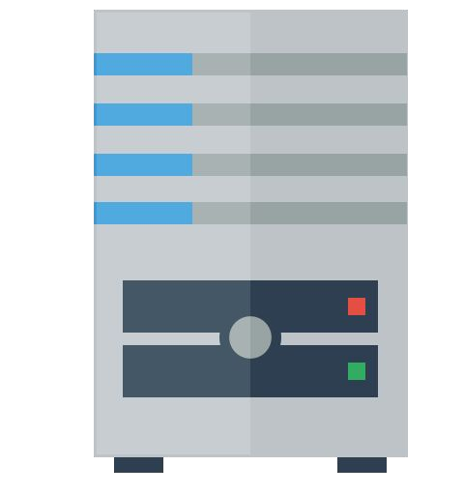
How do web pages work?
4. The browser reads the HTML, sees the embedded resources and asks the server for
those as well.
GET
OK
...
GET
OK

Slide 29

How do web pages work?
5. The web page is loaded when all the resources are fetched and displayed.

Slide 30
P.S.
(That was obviously very hand-wavy. We'll get more detailed when we talk about servers later in the course.)

Slide 31
Pause

Slide 32
Video 3 – What is CSS

Slide 33
CSS

Slide 34
CSS
CSS: Cascading Style Sheets
Describes the appearance and layout of a web page
Composed of CSS rules, which define sets of styles
selector {
property: value;
}

Slide 35
CSS
A CSS file is composed of style rules:
selector {
property: value;
}
selector: Specifies the HTML element(s) to style.
property: The name of the CSS style.
value: The value for the CSS style.
Saved in a filename.css file.

Slide 36
Pause

Slide 37

// NOT REAL CSS
fork {
CSS
color: gold;
}
"All forks on the table should be gold"

Slide 38
Pause – Earlier we talked about

Slide 39

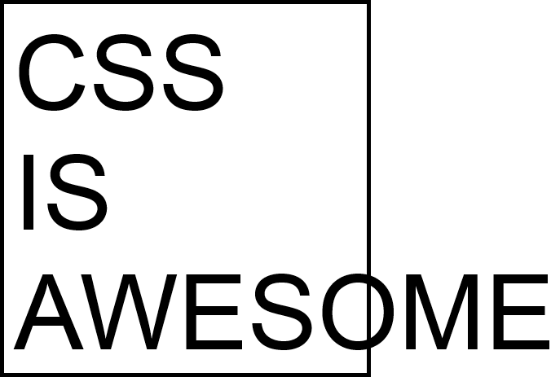
Why frustration free!!
Every beginner CSS tutorial makes CSS look trivially easy:
body {
background-color: red;
}
But then when you try to write CSS, literally nothing works:

Slide 40
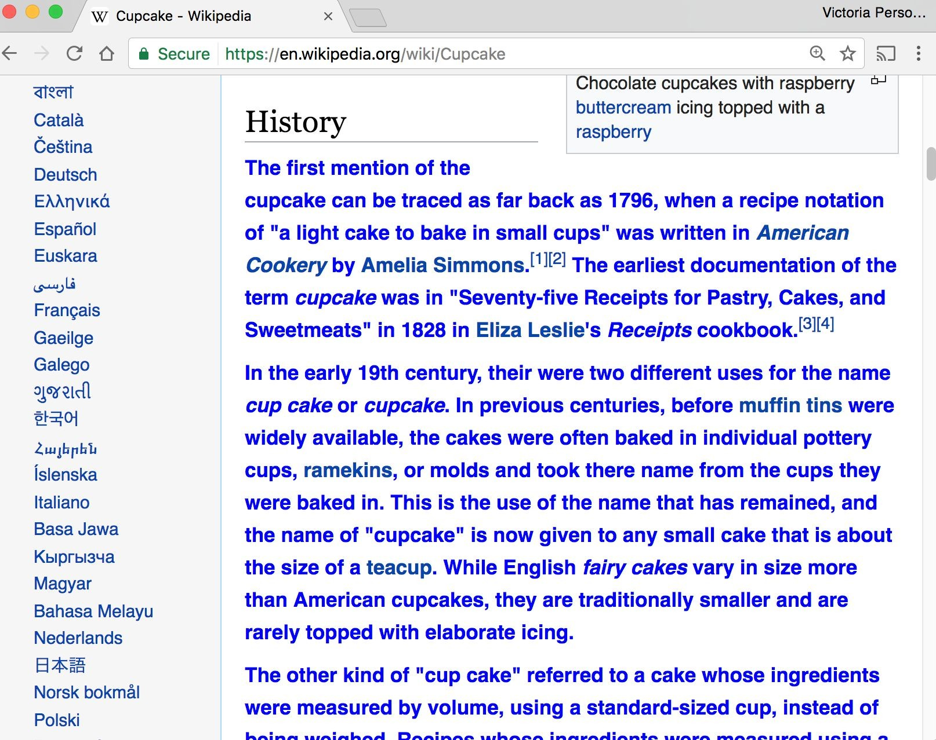
CSS
p {
color: blue;
font-weight: bold;
}
"All <p> elements on the page should be blue and bold"

Slide 41
Pause

Slide 42
Video 4 – Adding CSS to your HTML File

Slide 43
Linking CSS in HTML
(i.e. copy/paste boilerplate)
<!DOCTYPE html>
<html>
<head>
<title>Web Course</title>
<link rel="stylesheet" href="filename.css" />
</head>
<body>
... contents of the page...
</body>
</html>

Slide 44
Adding CSS directly
(i.e. copy/paste boilerplate)
<!DOCTYPE html>
<html>
<head>
<title>Web Course</title></head>
<body>
<style>
…styles goes here
</style>
... contents of the page...
</body>
</html>

Slide 45
Pause

Slide 46
Video 5 – CSS Properties

Slide 47
Some CSS properties
There are over 500 CSS properties! Here are a few:
Font face (mdn) | font-family: Helvetica;
Font color (mdn) | color: gray;
Background color (mdn) | background-color: red;
Border (mdn) | border: 3px solid green;
Text alignment (mdn) | text-align: center;
Aside: Mozilla Developer Network (MDN) is the best reference for HTML elements and CSS properties
- The actual W3 spec is very hard to read (meant for browser developers, not web developers)

Slide 48
Main ways to define CSS colors:
140 predefined names (list)
color: black;
Hex values
color: #00ff00; color: #0f0; color: #00ff0080;
rgb() and rgba()
color: rgb(34, 12, 64);
color: rgba(0, 0, 0, 0.5);
The "a" stands for alpha channel and is a transparency value
Generally prefer more descriptive over less:
Predefined name
rgb / rgba
Hex

Slide 49
Pause

Slide 50
Video 6 – Course Page Exercise

Slide 51
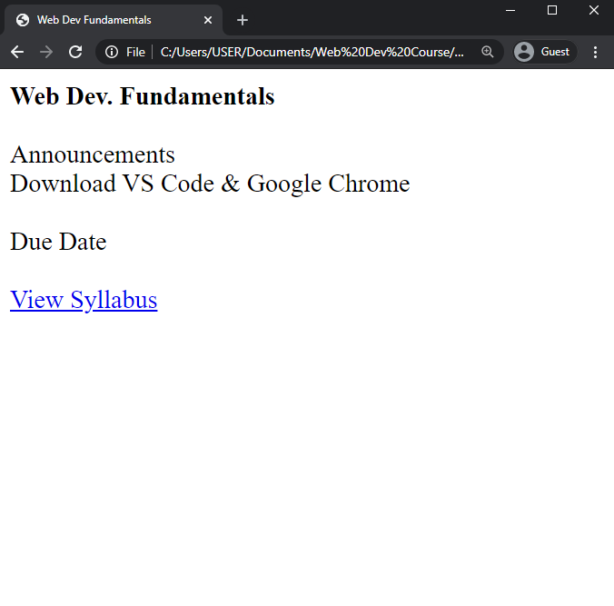
Exercise: Course web page
Let's write some CSS to style our page:

Slide 52
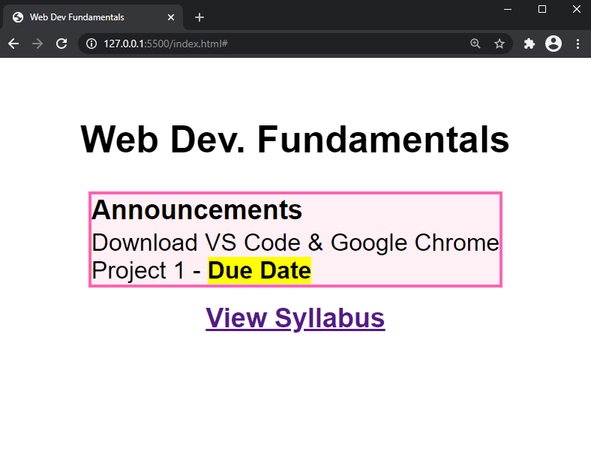
Exercise: Course web page
Let's write some CSS to style our page:

Slide 53
Pause

Slide 54
Exercise: Course web page
Let's write some CSS to style our page:
Font face: Sans Serif
Border: hotpink 2px Background color: lavenderblush Highlight: yellow
Box is centered
Header and link are
centered
Box contents are
left-aligned
JSBin

Slide 55
CSS exercise debrief
Some key techniques:
Add invisible containers in HTML to select groups of elements in CSS.
Apply styles to parent / ancestor element to style parent and all its children. (Will talk more about this later.)

Slide 56
Pause

Slide 57
CSS exercise debrief
Some key techniques:
Add invisible containers in HTML to select groups of elements in CSS.
Apply styles to parent / ancestor element to style parent and all its children. (Will talk more about this later.)
But we encountered more weirdness...
Couldn't set text-align: center; to the <a> or
<strong> tags directly, but could center <p> and <h1>
Had to set a width on the box to make it hug the text …
any other way to do this?
How to center the box?! How do you highlight?!

Slide 58
Pause

Slide 59
Video 7 – Bizarre Nature of HTML/CSS

Slide 60
Q: Why is HTML/CSS so bizarre??

Slide 61
A: There is one crucial set of rules we haven't learned yet…
block vs inline display

Slide 62
Recap HTML

Slide 63
What is HTML?
HTML (Hypertext Markup Language)
Describes the content and structure of a web page
Made up of building blocks called elements.
<p>
HTML is <em>awesome!!!</em>
<img src="puppy.png" />
</p>
And there are 3 basic types.

Slide 64
Types of HTML elements
Each HTML element is categorized by the HTML spec into one of three-ish categories:
block: large blocks of content, has height and width
<p>, <h1>, <blockquote>, <ol>, <ul>, <table>
inline: small amount of content, no height or width
<a>, <em>, <strong>,<br>
inline block: inline content with height and width
<img>
metadata: information about the page, usually not visible
<title>, <meta>

Slide 65
Pause

Slide 66
Video 7 – Block Elements

Slide 67
Block elements
Examples:
<p>, <h1>, <blockquote>, <ol>, <ul>, <table>
Take up the full width of the page (flows top to bottom)
Have a height and
width
Can have block or inline elements as children

Slide 68
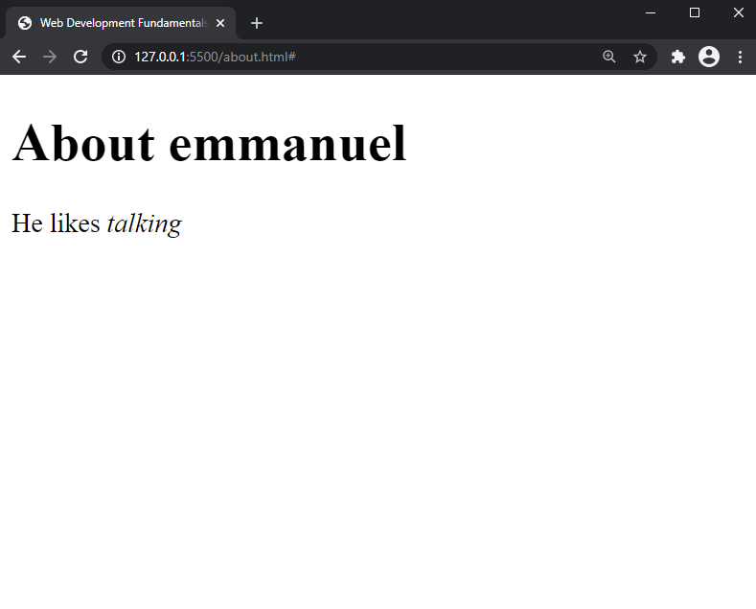
Example: Block
<h1>About emmanuel</h1>
<p>
He likes <em>talking</em>
</p>
Notes:
Display on screen

Slide 69
Pause

Slide 70
Q: What does this look like in the
browser?
h1 {
border: 5px solid red;
}
<h1>About emmanuel</h1>
<p>
He likes <em>talking</em>
</p>

Slide 71
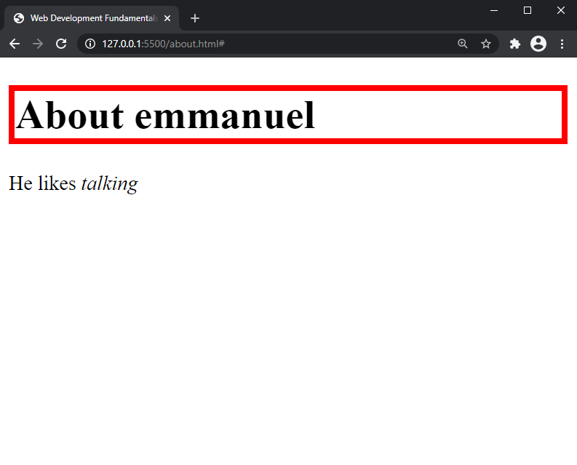

Slide 72
Pause

Slide 73
Block-level:
extends the full width of the page
h1 {
border: 5px solid red;
}
<h1>About emmanuel</h1>
<p>
He likes <em>talking</em>
</p>
<h1> is block-level, so it extends the full width of the page by default
Note how block-level elements (h1, p) flow top to bottom
See: JSBin

Slide 74
Q: What does this look like in the
browser?
h1 {
border: 5px solid red;
width: 50%;
}
<h1>About emmanuel</h1>
<p>
He likes <em>talking</em>
</p>

Slide 75
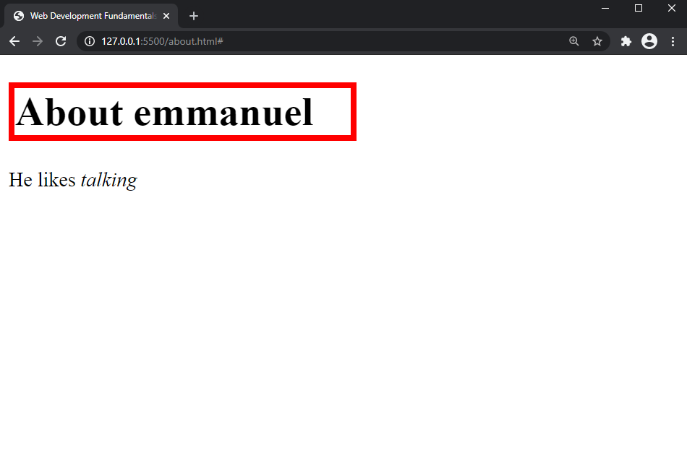

Slide 76
Pause

Slide 77
Block-level
width can be modified
h1 { border: 5px | solid | red; |  | <h1>About vrk</h1> <p>
width: 50%; |  |  |  | She likes <em>puppies</em>
} |  |  |  | </p>
<h1> is block-level, so its width can be modified
Block-level elements still flow top to bottom
See: JSBin

Slide 78
Pause

Slide 79
Video 8 – Inline Elements

Slide 80
Inline elements
Examples:
<a>, <em>, <strong>, <br>
Take up only as much width as needed (flows left to right)
Cannot have height and width
Cannot have a block element child
Cannot be positioned (i.e. CSS properties like float and position do not apply to inline elements)
Must position its containing block element instead

Slide 81
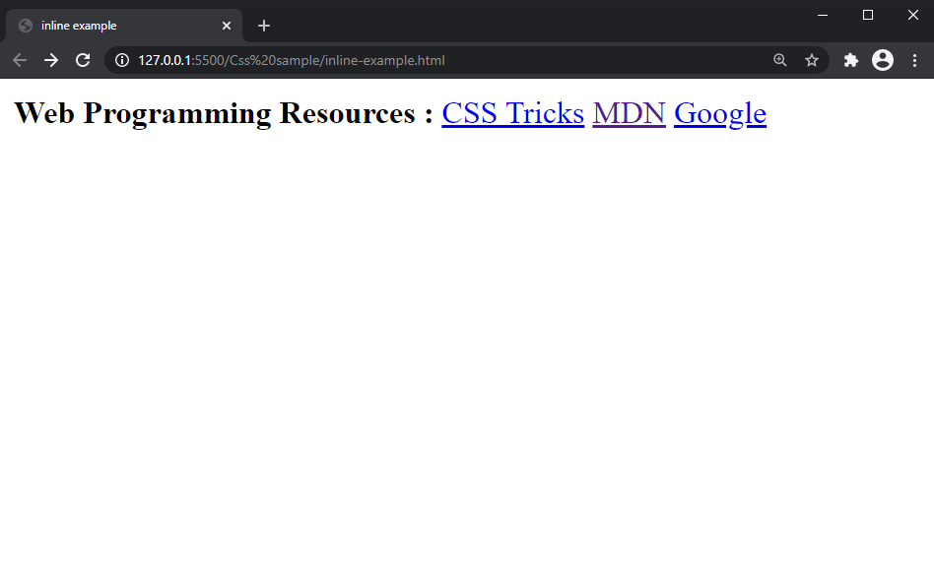
Example: Inline
< < < | strong>Web programming Resources:</strong> a href="https://css-tricks.com/">CSS Tricks</a> a href="https://developer.mozilla.org/en-US/">MDN</a>
<a href="http://google.com">Google</a>
JSBIN

Slide 82
Pause

Slide 83
Q: What does this look like in the
browser?
strong {
border: 5px solid red; width: 1000px;
}
 | strong>Web programming Resources:</strong>
 | a href="https://css-tricks.com/">CSS Tricks</a>
 | a href="https://developer.mozilla.org/en-US/">MDN</a>
 | a href="http://google.com">Google</a>

Slide 84
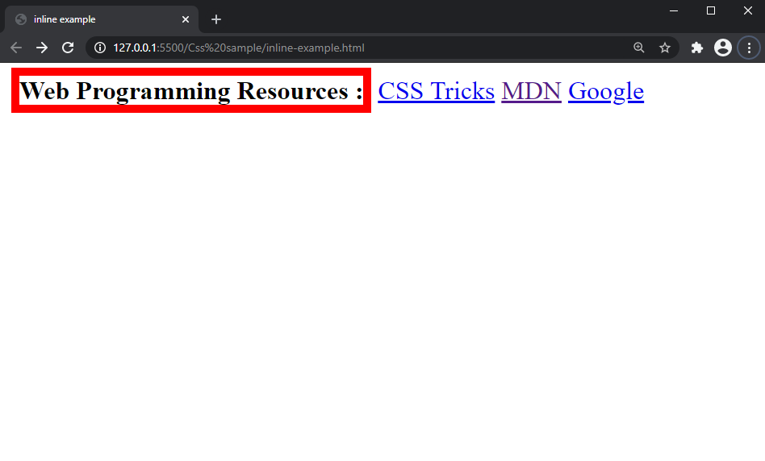
JSBIN

Slide 85
Pause

Slide 86
Inline elements ignore width
width cannot be modified
strong {
border: 5px solid red;
width: 1000px;
/* Will not work; strong is inline! */
}
<strong>Web programming reso
<a href="http://cs193x.stanf
<a href="https://developer.m
<a href="http://google.com">
Cannot set width on inline element, so it is ignored (JSBin)

Slide 87
Pause

Slide 88
inline-block
Examples: <img>, any element with
display: inline-block;
Take up only as much width as needed (flows left to right)
Can have height and width
Can have a block element as a child
Can be positioned (i.e. CSS properties like float and position apply)

Slide 89
Video 9 – Inline Block Elements

Slide 90

Example: Inline-block
img {
width: 50px;
}
Q: What does this look like in the browser?
<img | src="http://i.imgur.com/WJToVGv.jpg" | />
<img | src="http://i.imgur.com/WJToVGv.jpg" | />
<img | src="http://i.imgur.com/WJToVGv.jpg" | />
<img | src="http://i.imgur.com/WJToVGv.jpg" | />
<img | src="http://i.imgur.com/WJToVGv.jpg" | />
http://i.imgur.com/WJToVGv.jpg =

Slide 91
Pause

Slide 92
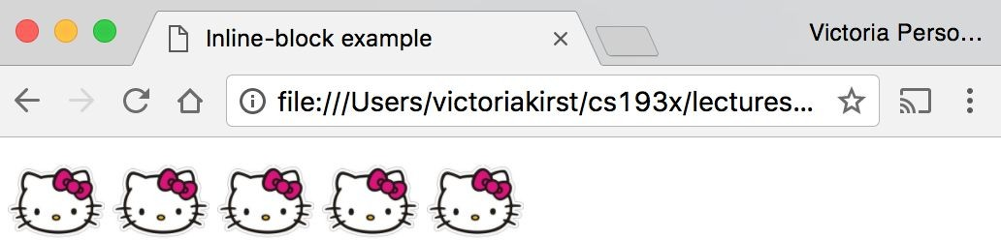

Slide 93
Inline-block
Has width and height; flows left to right
Can set width on inline-block element, so image width is set to 50px. (JSBin)
inline-block flows left to right, so images are right next to each other.
<img | src="http://i.imgur.com/WJToVGv.jpg" | />
<img | src="http://i.imgur.com/WJToVGv.jpg" | />
<img | src="http://i.imgur.com/WJToVGv.jpg" | />
<img | src="http://i.imgur.com/WJToVGv.jpg" | />
<img | src="http://i.imgur.com/WJToVGv.jpg" | />
img {
width: 50px;
}

Slide 94
Pause

Slide 95
Video 10 – Display property

Slide 96
The display CSS property
You can change an element's default rendering type by changing the display property. Examples:
p {
display: inline;
}
a {
display: block;
}
Possible values for display:
block
inline
inline-block
- some others: link

Slide 97
Pause

Slide 98
Video 11 – Review and Morale

Slide 99
Review
block: flows top-to-bottom; has height and width
<p>, <h1>, <blockquote>, <ol>, <ul>, <table>
inline: flows left-to-right; does not have height and width
<a>, <em>, <strong>,<br>
inline block: flows left-to-right; has height and width
<img>

Slide 100
Moral of the story:
If your CSS isn't working, see if you're trying to apply block-level properties to inline elements

Slide 101
Extra slides
1. The course is adopted from vrkirst’s lectures on Web Programming class. You can check the original page at http://cs193x.stanford.edu for the original course materials.
2. https://www.youtube.com/watch?v=Dxcc6ycZ73M
3. https://www.techopedia.com/definition/2419/internet
4. https://www.theguardian.com/technology/2018/oct/22/what-is-the-internet-13-key-questions-answered
5. https://medium.freecodecamp.org/whats-the-document-object-model-and-why-you-should-know-how-to-use-it-1a2d0bc5429d

Slide 102
Pause

Slide 103
Possibly – New Section

Slide 104
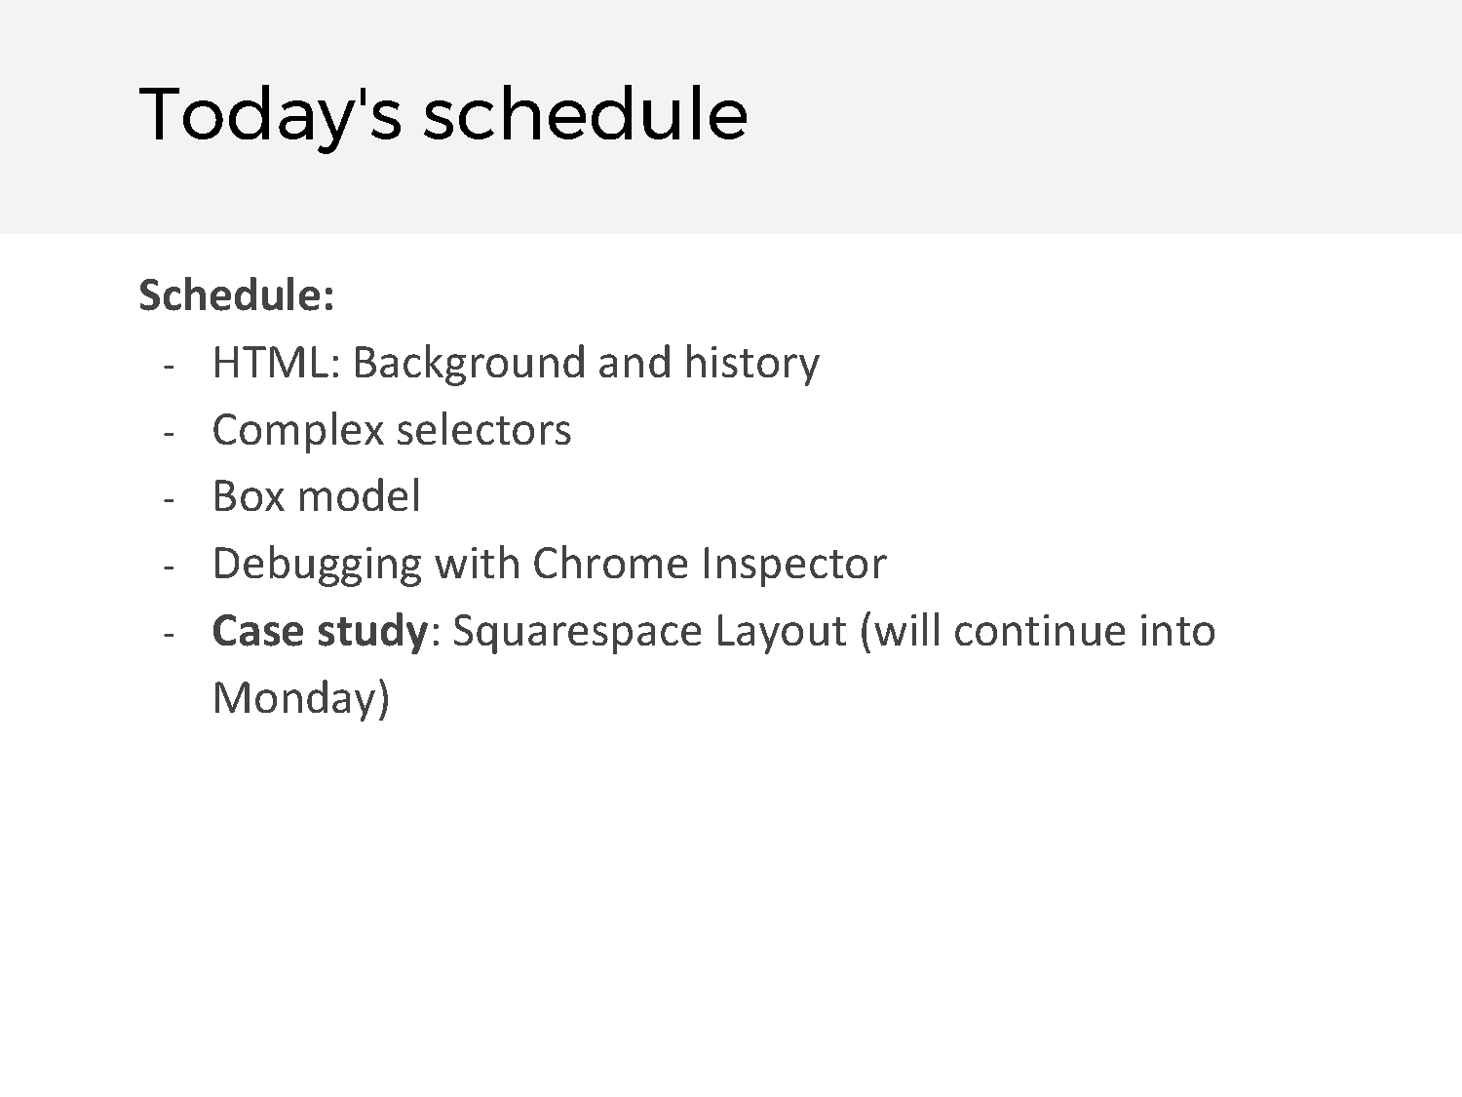

Slide 105
Video 12 – HTML History and Background

Slide 106
Pause - Incase

Slide 107
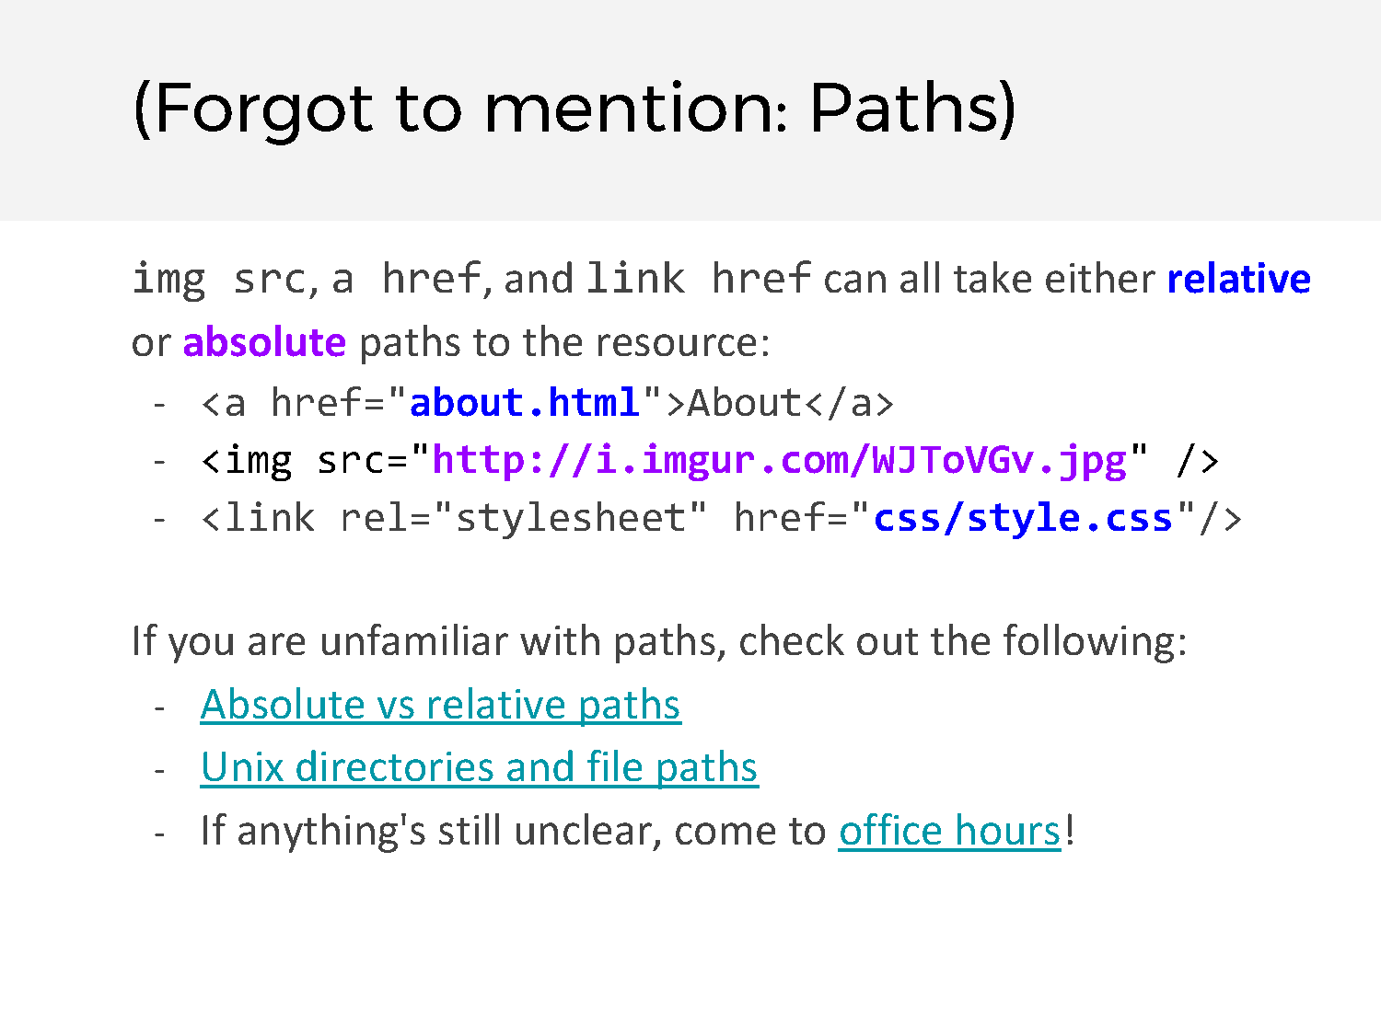

Slide 108
Pause

Slide 109


Slide 110
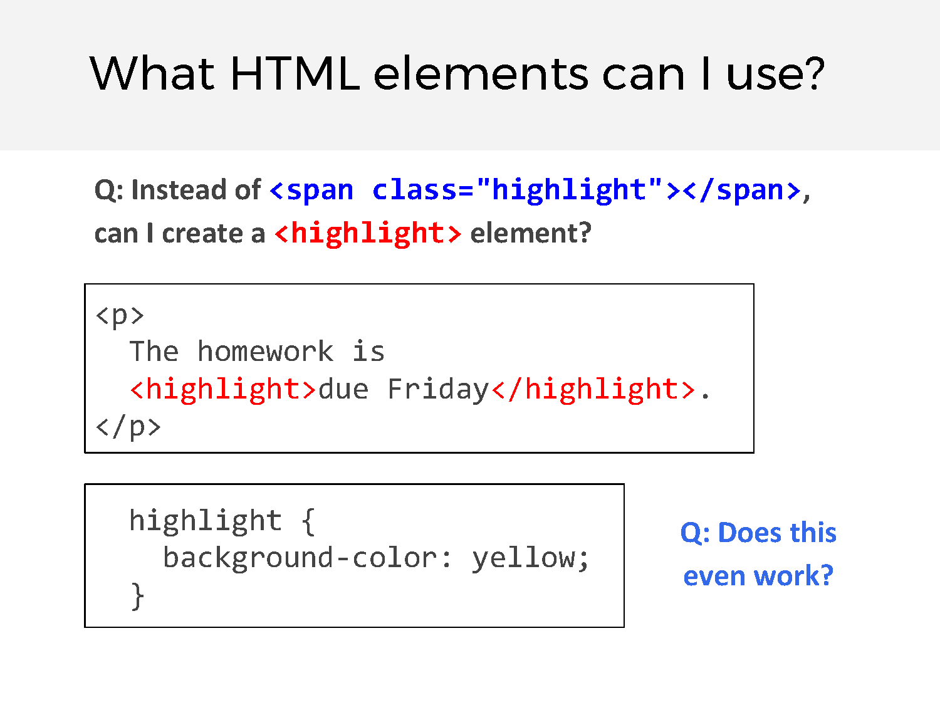

Slide 111
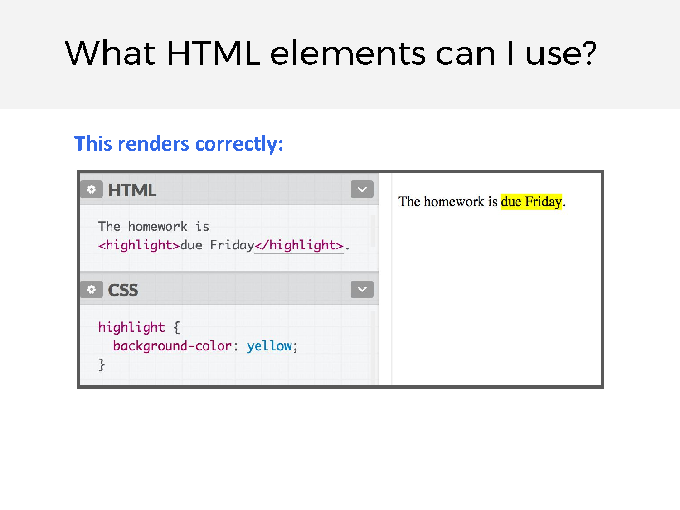

Slide 112
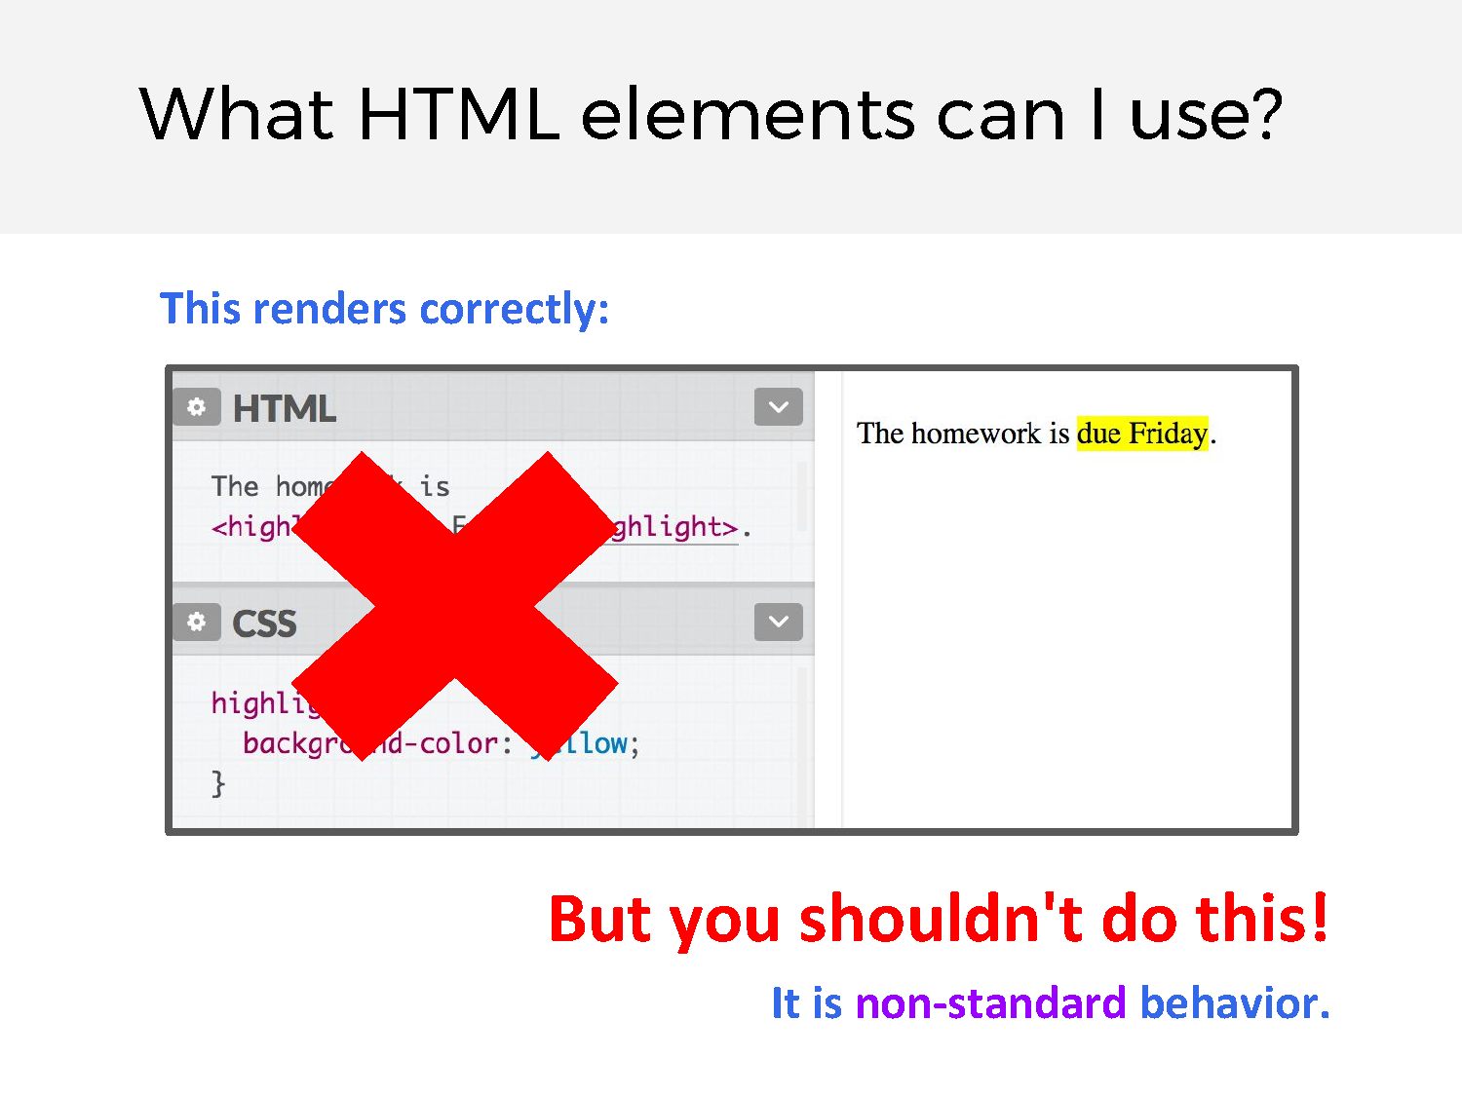

Slide 113
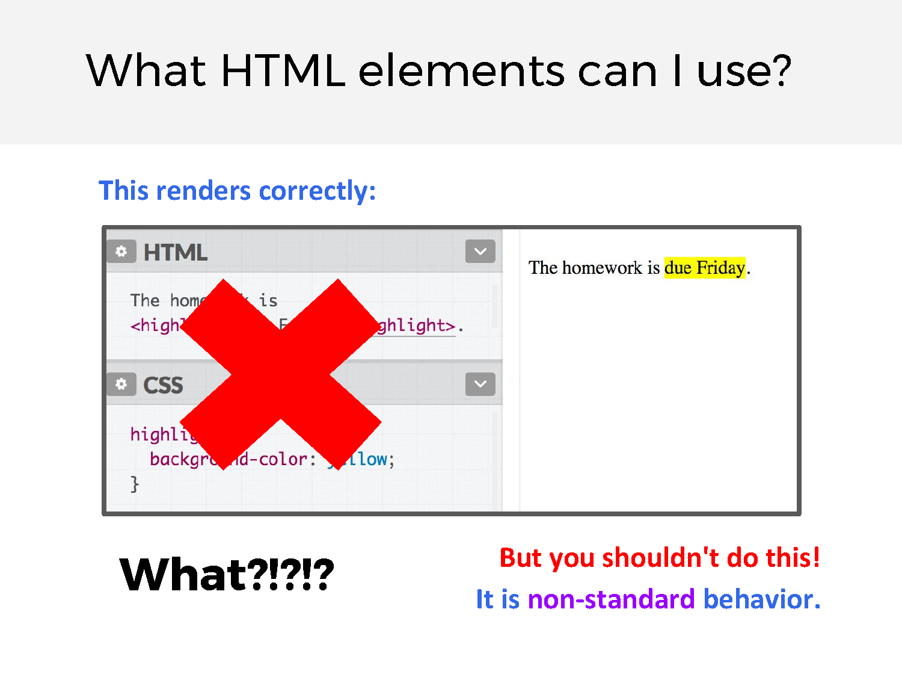

Slide 114
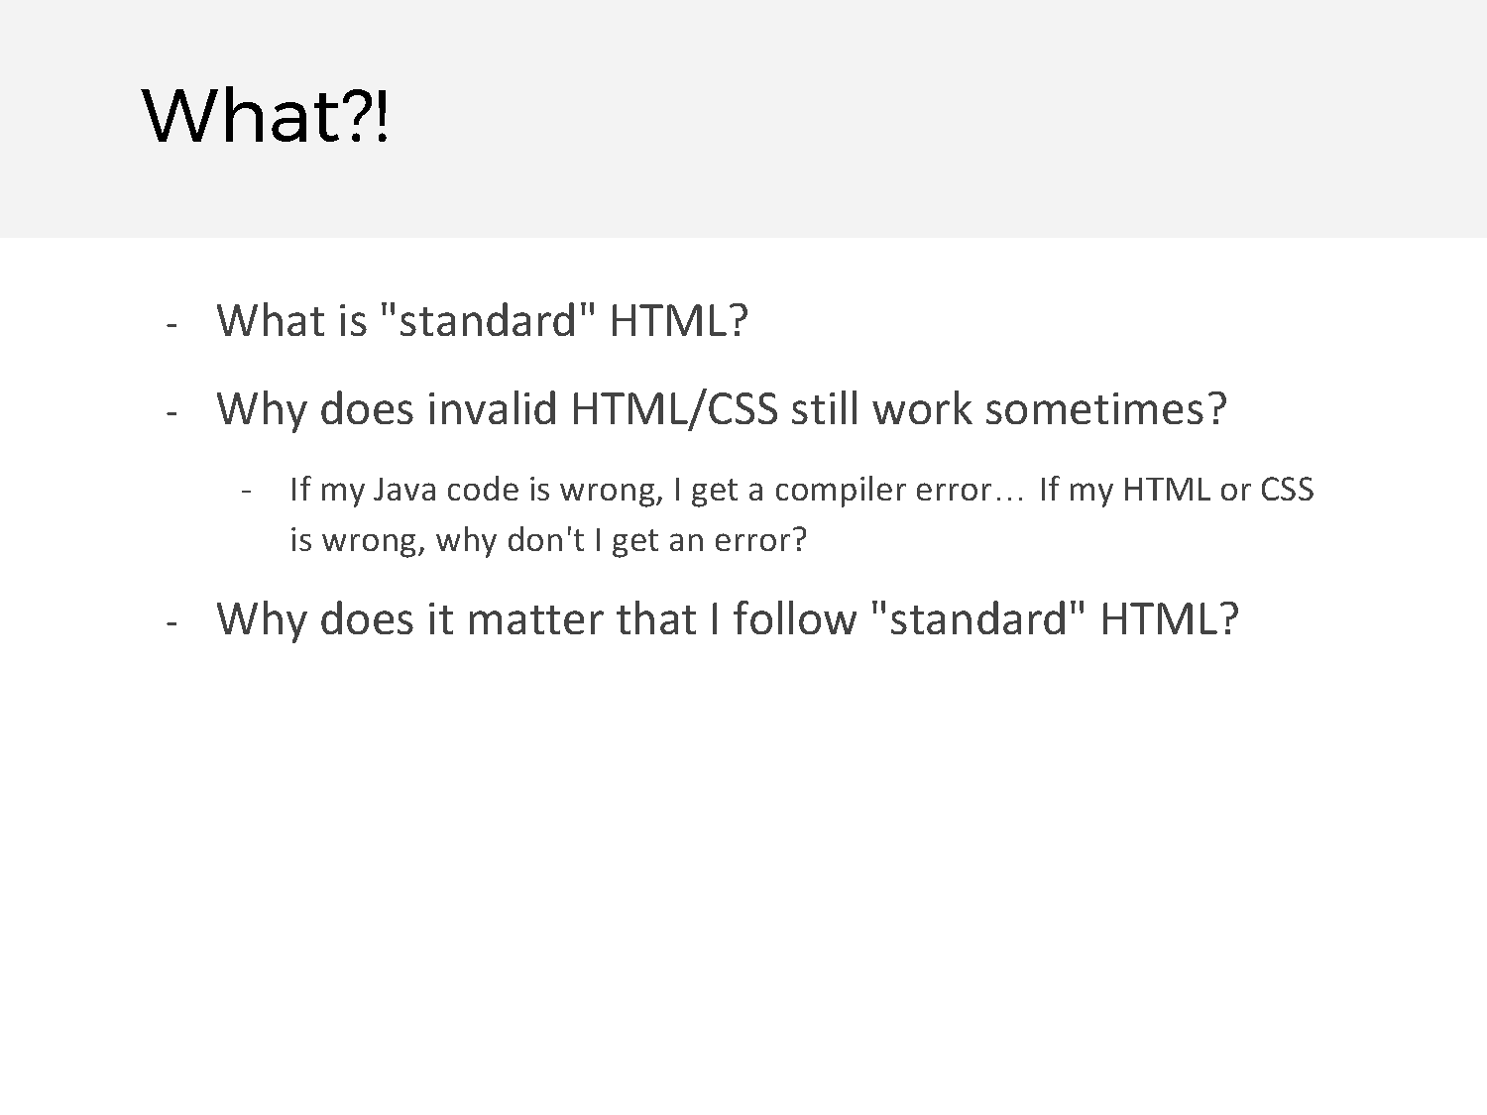

Slide 115
Pause

Slide 116
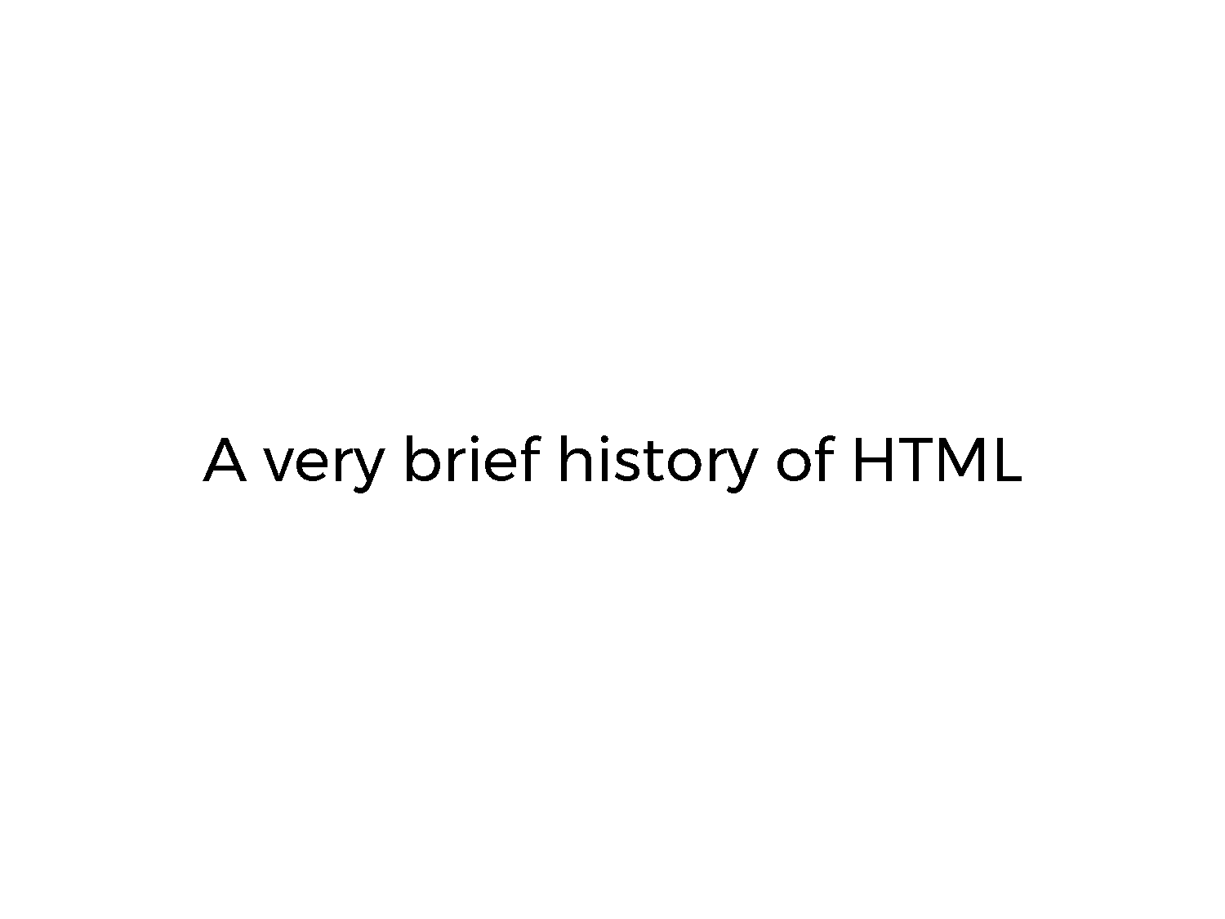

Slide 117
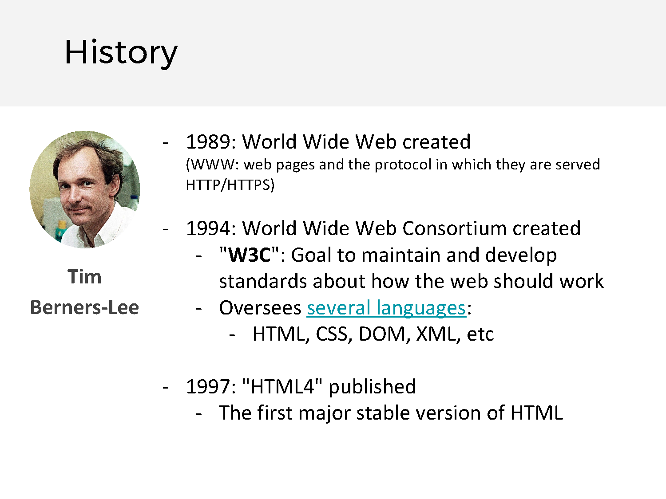
Notes:
Hermann Spoke about this in his video. Skimm through very fast

Slide 118
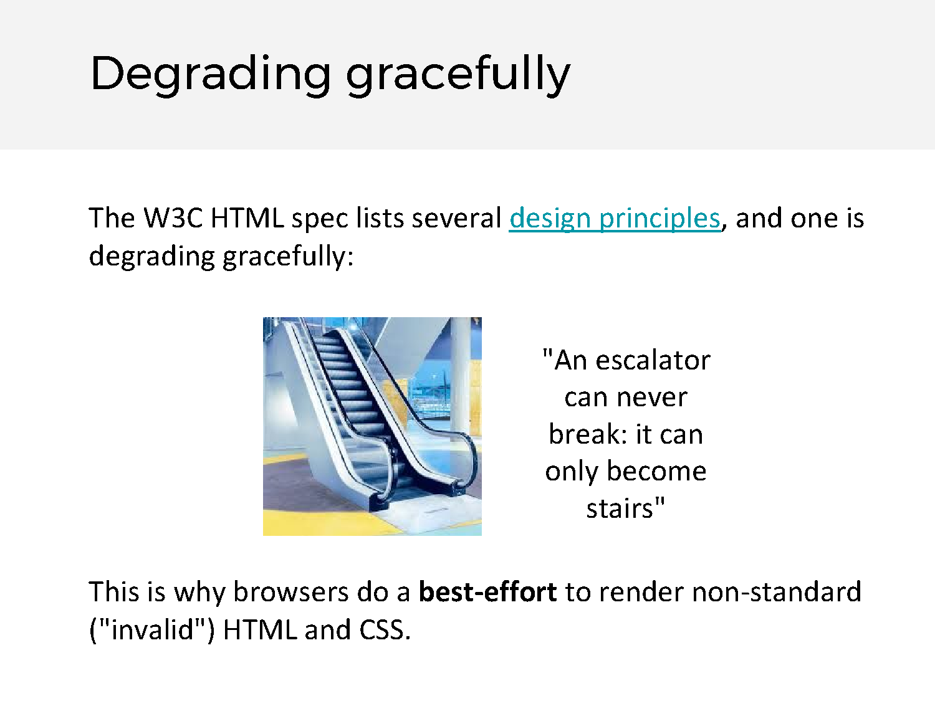

Slide 119
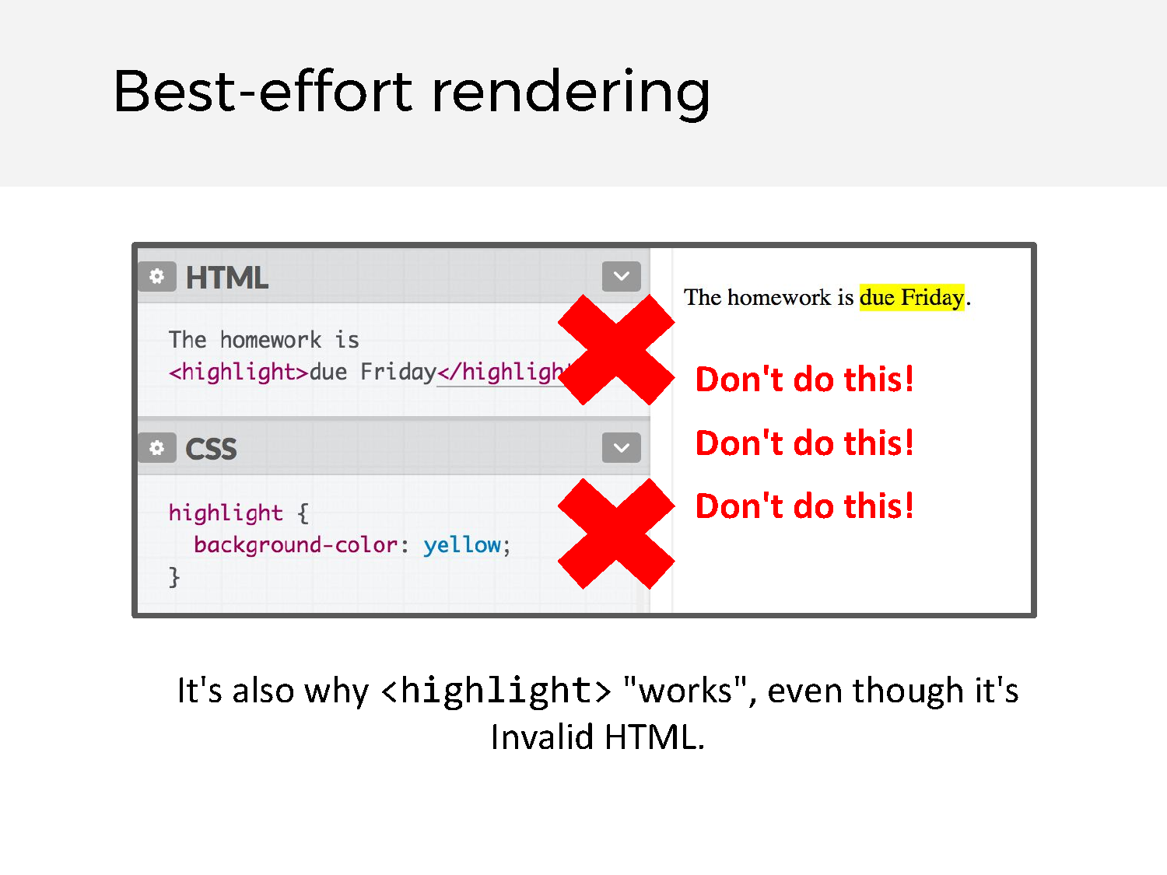

Slide 120
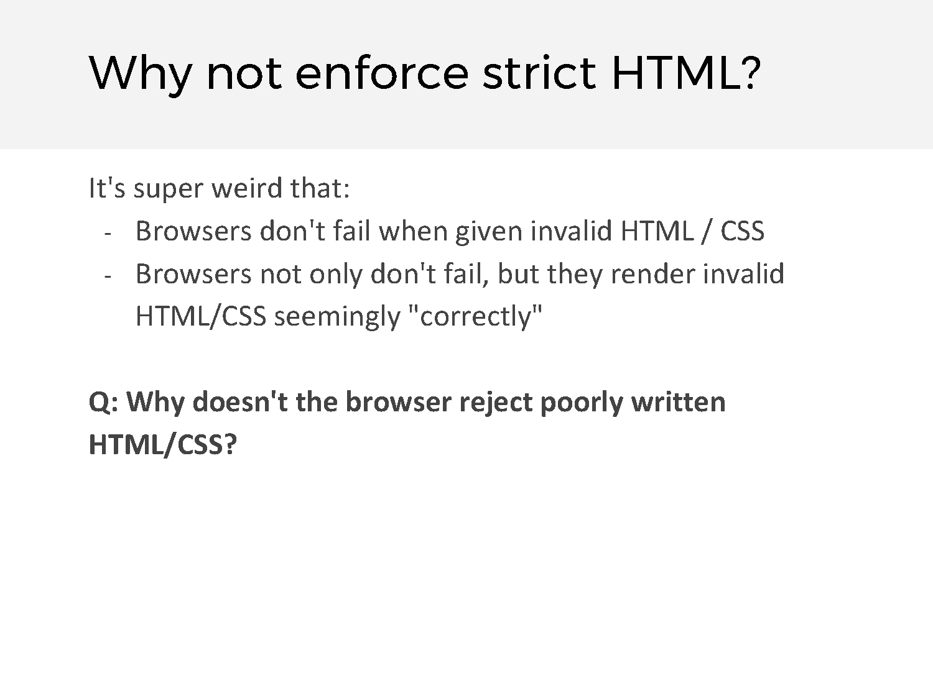

Slide 121
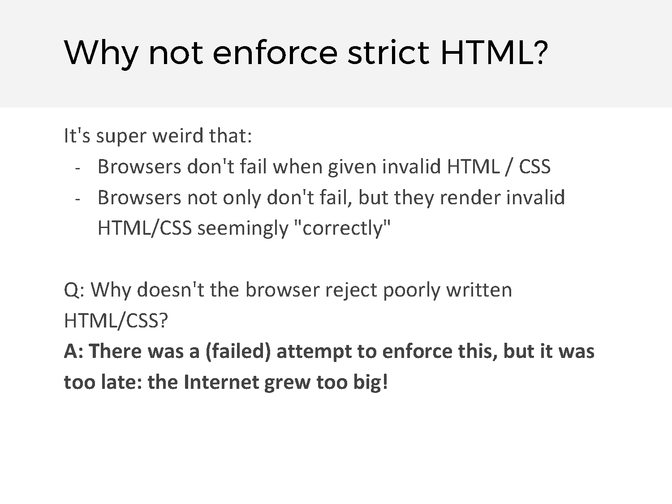

Slide 122
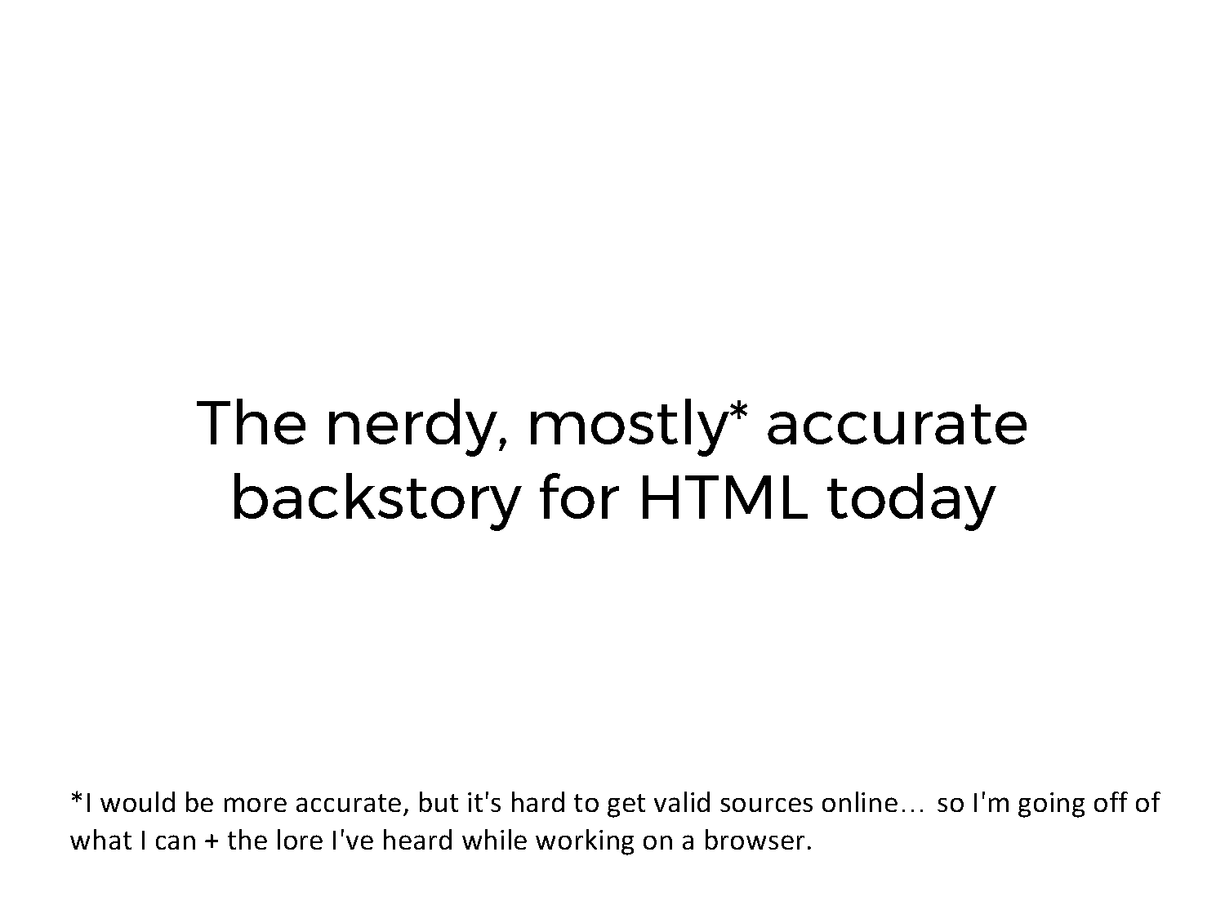

Slide 123
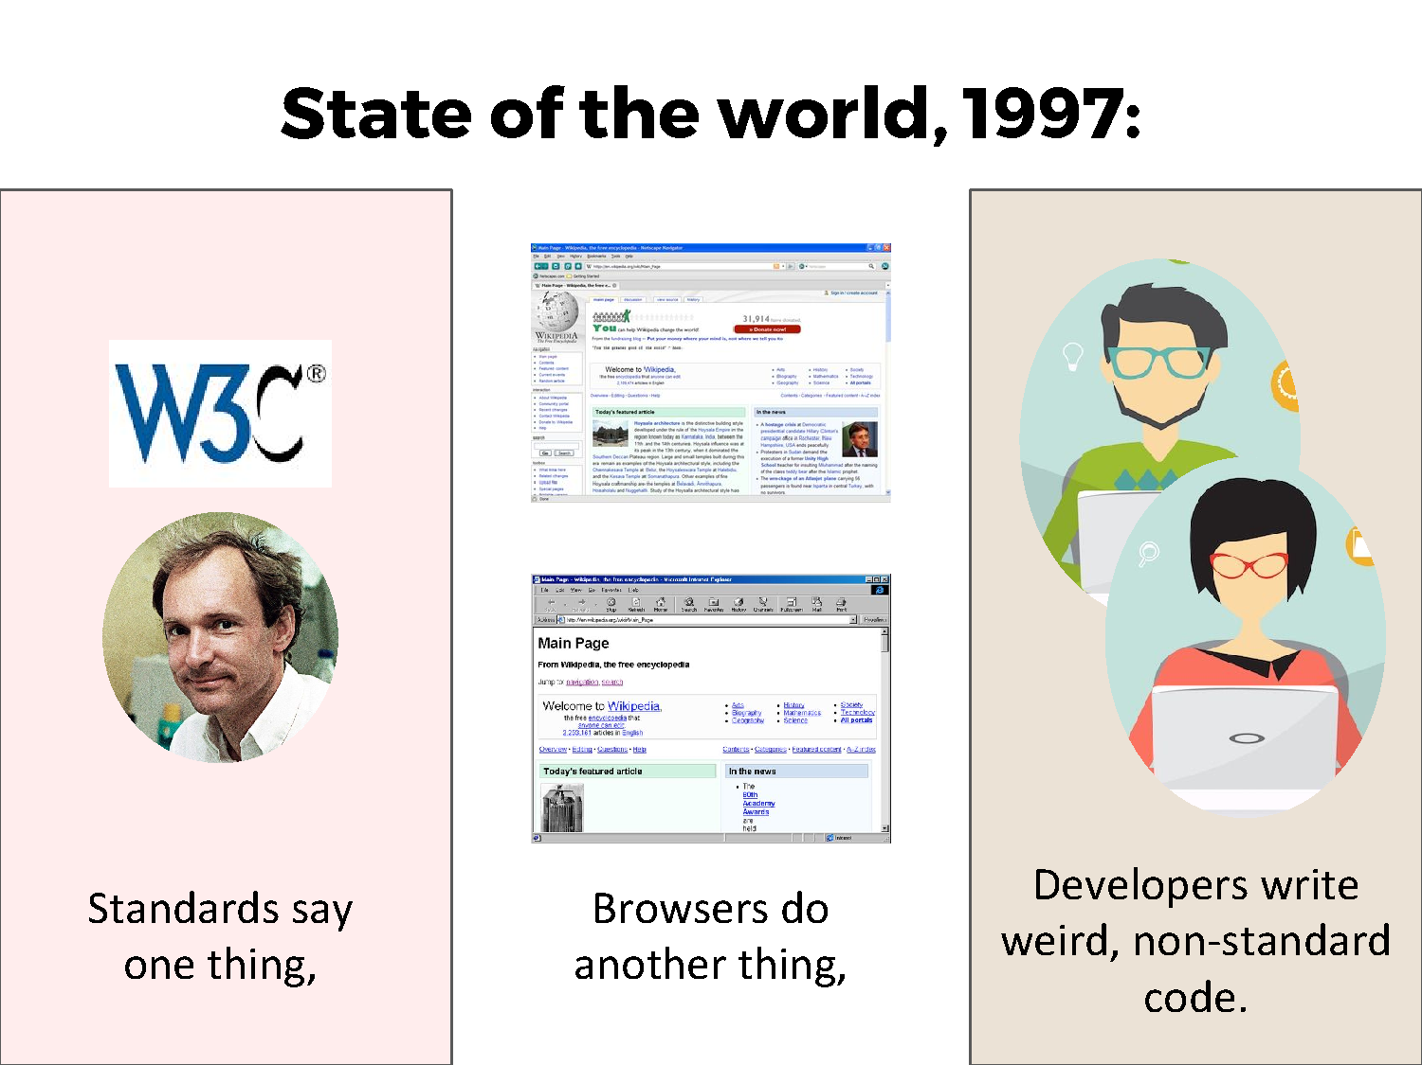

Slide 124
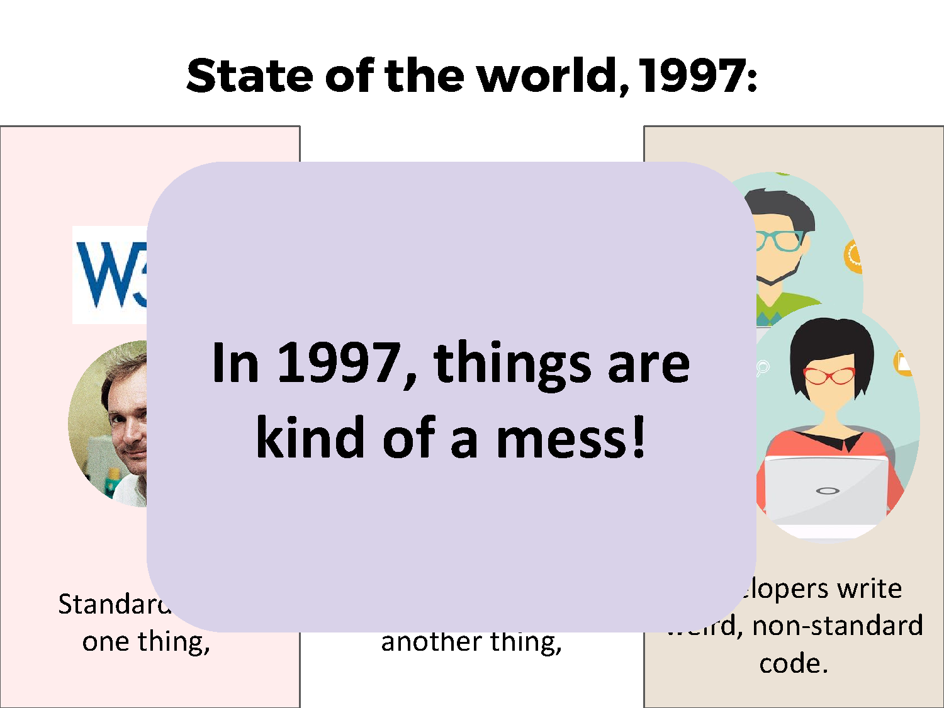

Slide 125
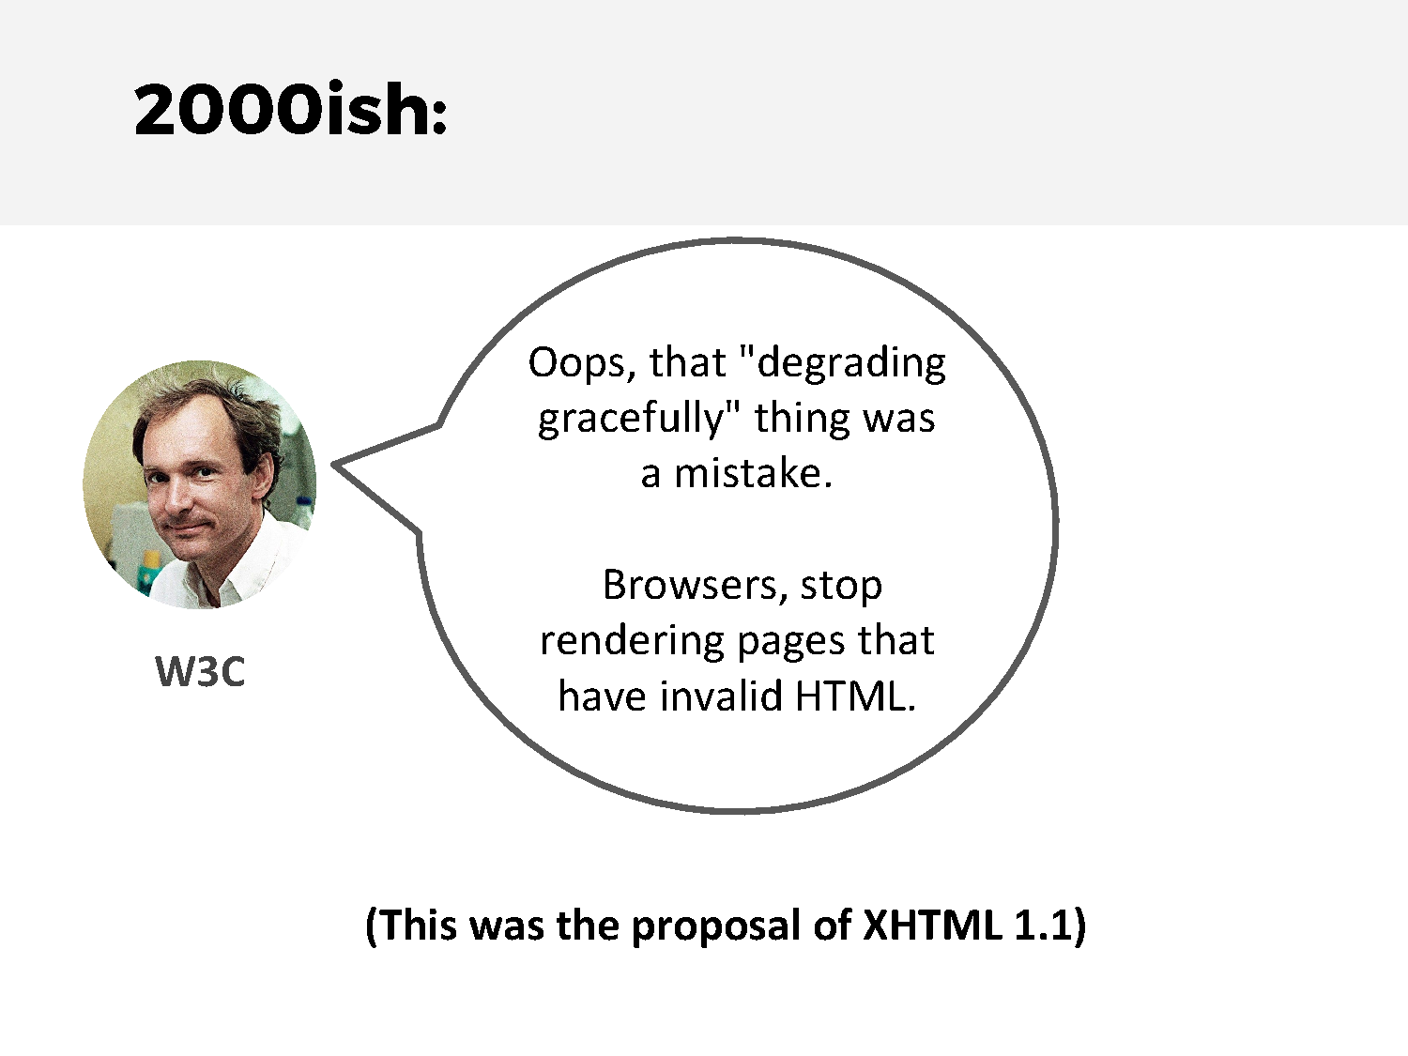

Slide 126
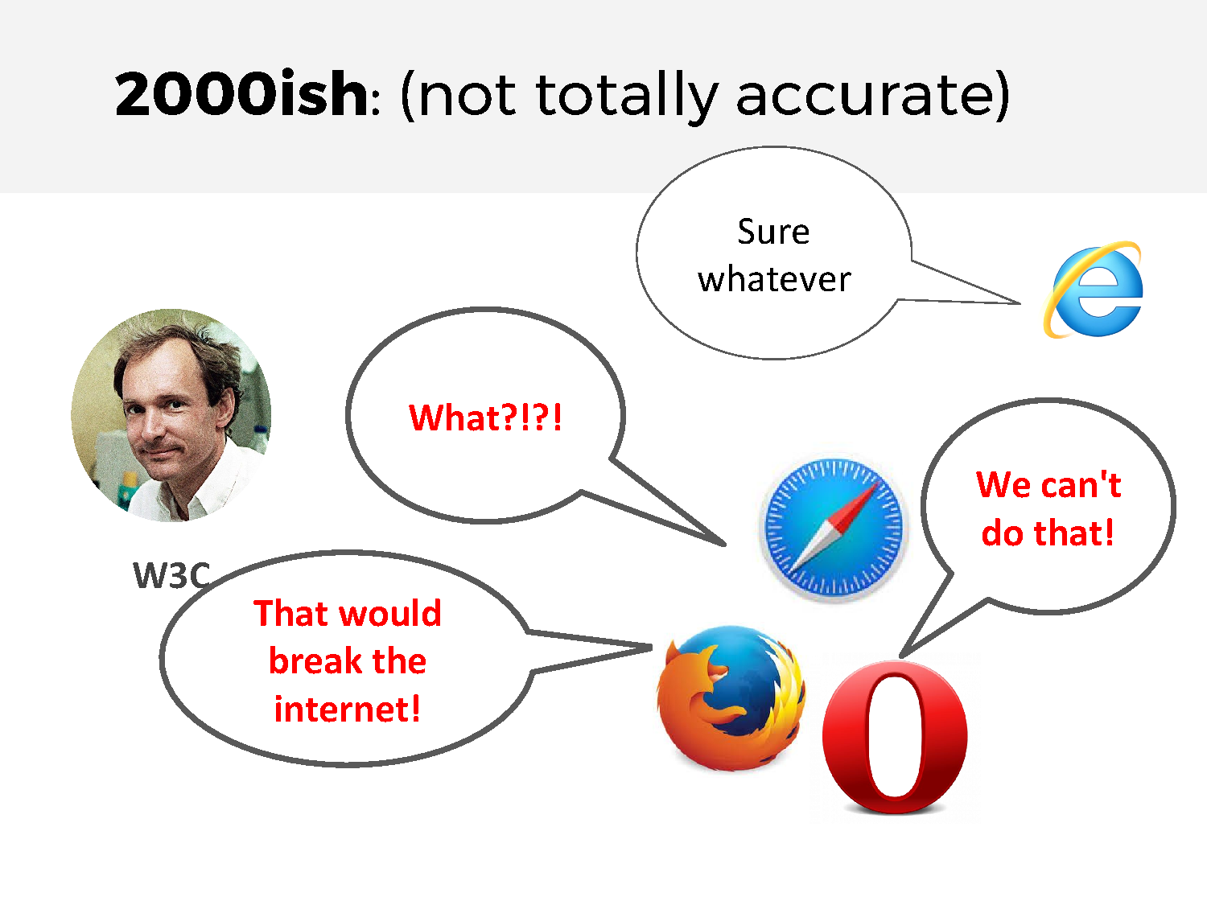

Slide 127
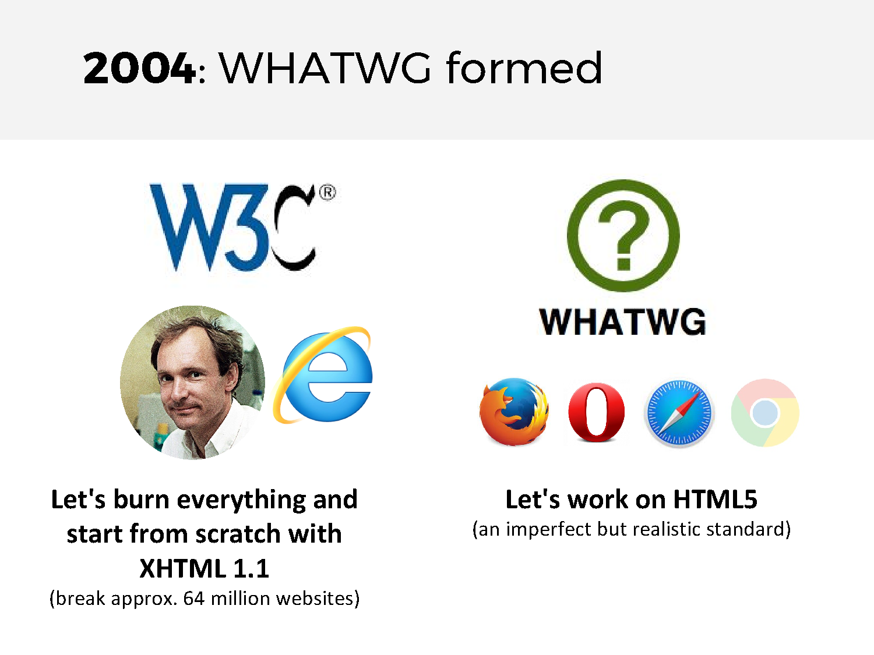

Slide 128
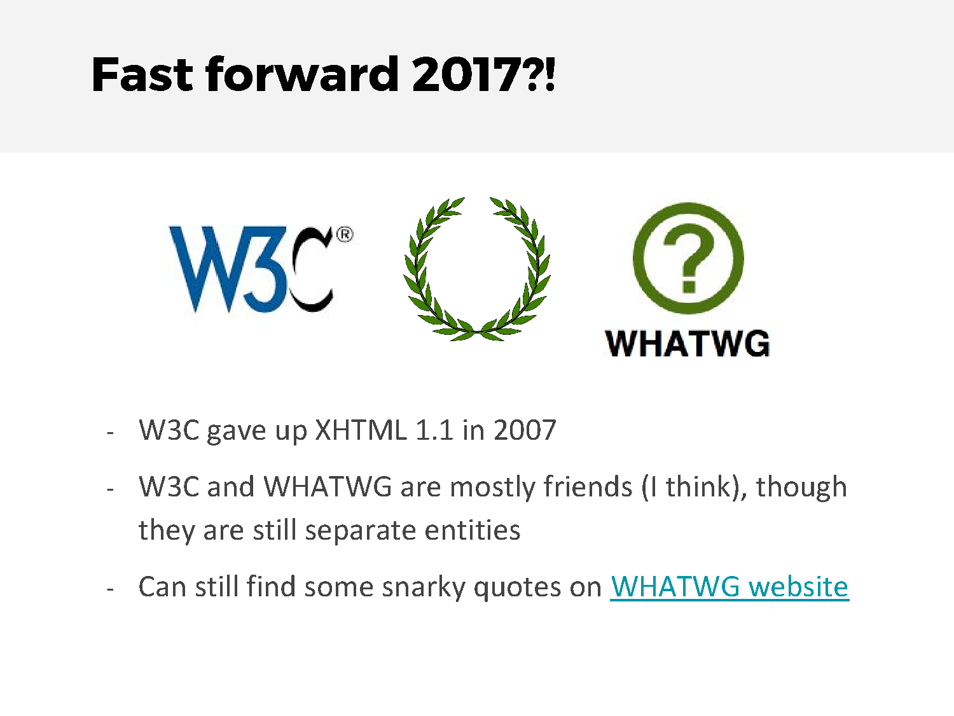

Slide 129
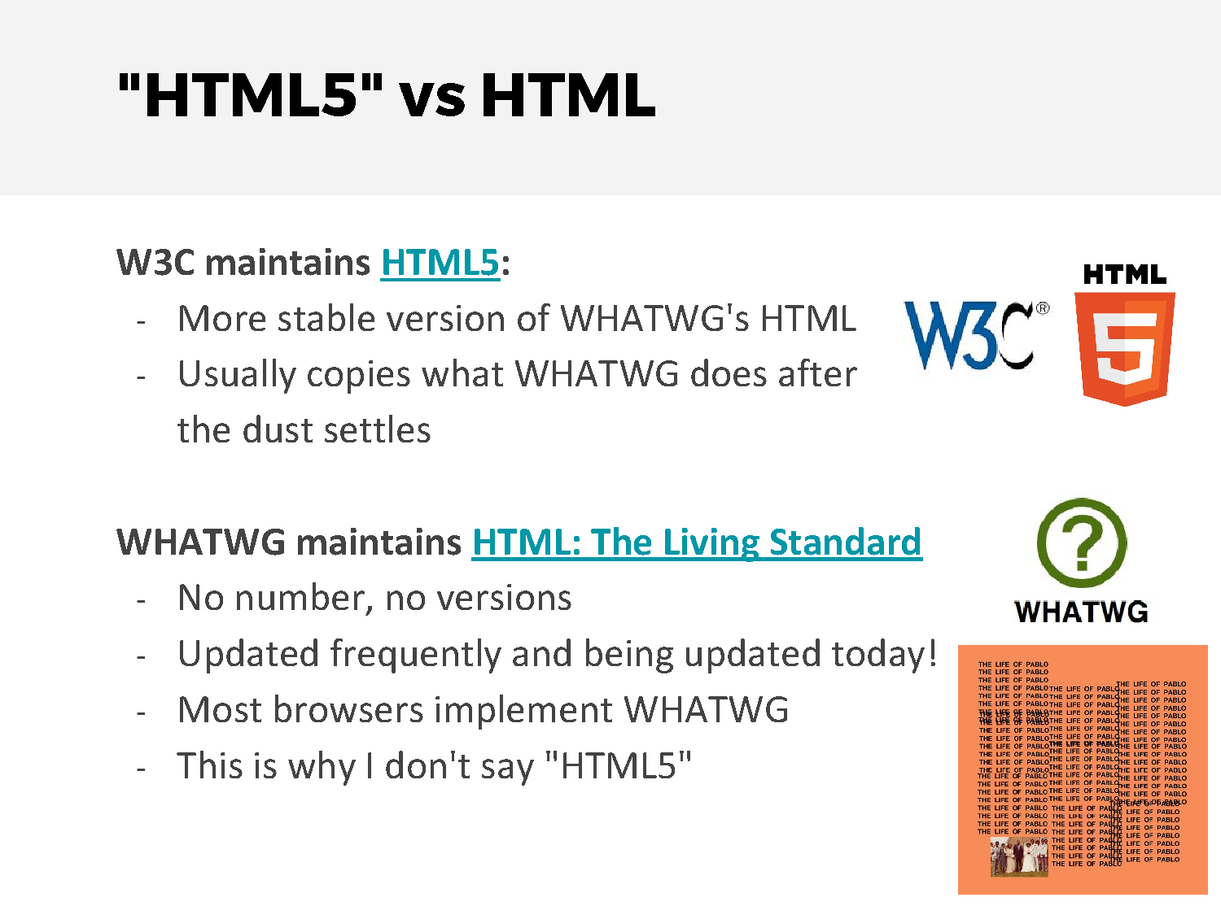

Slide 130
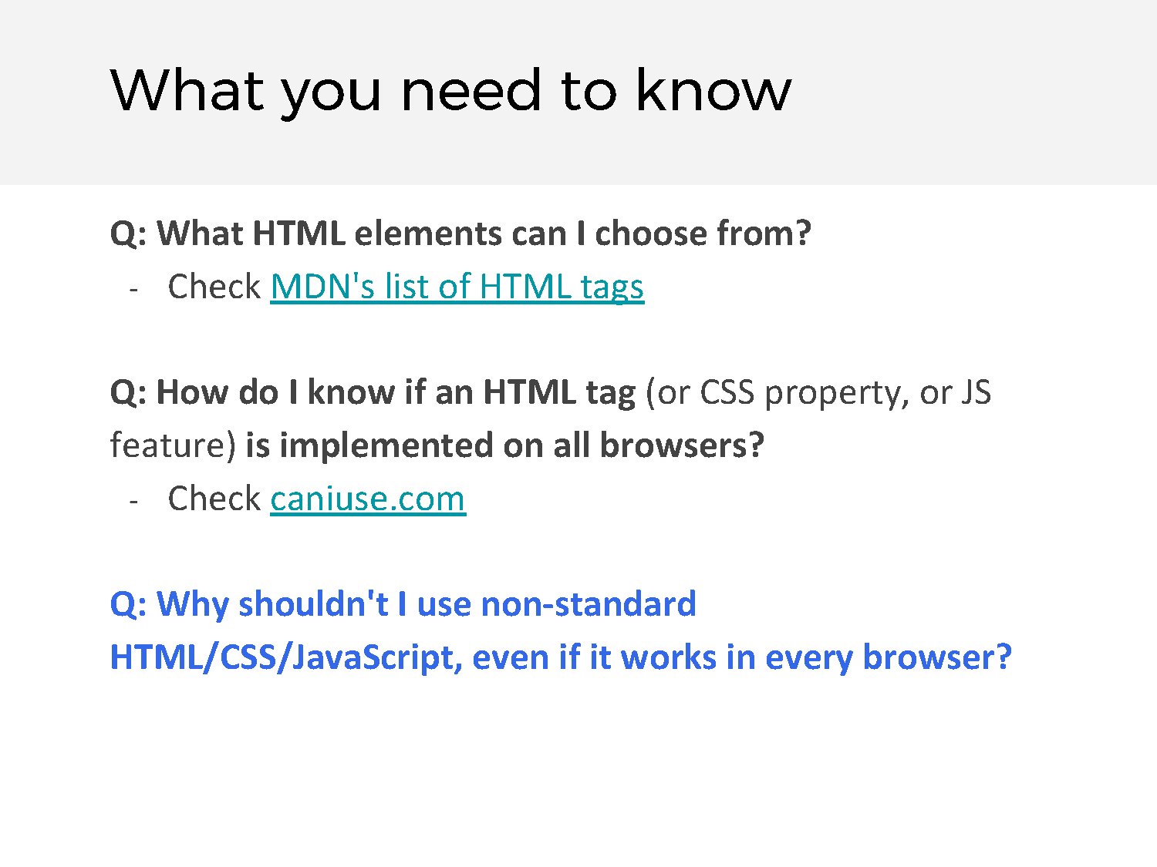

Slide 131
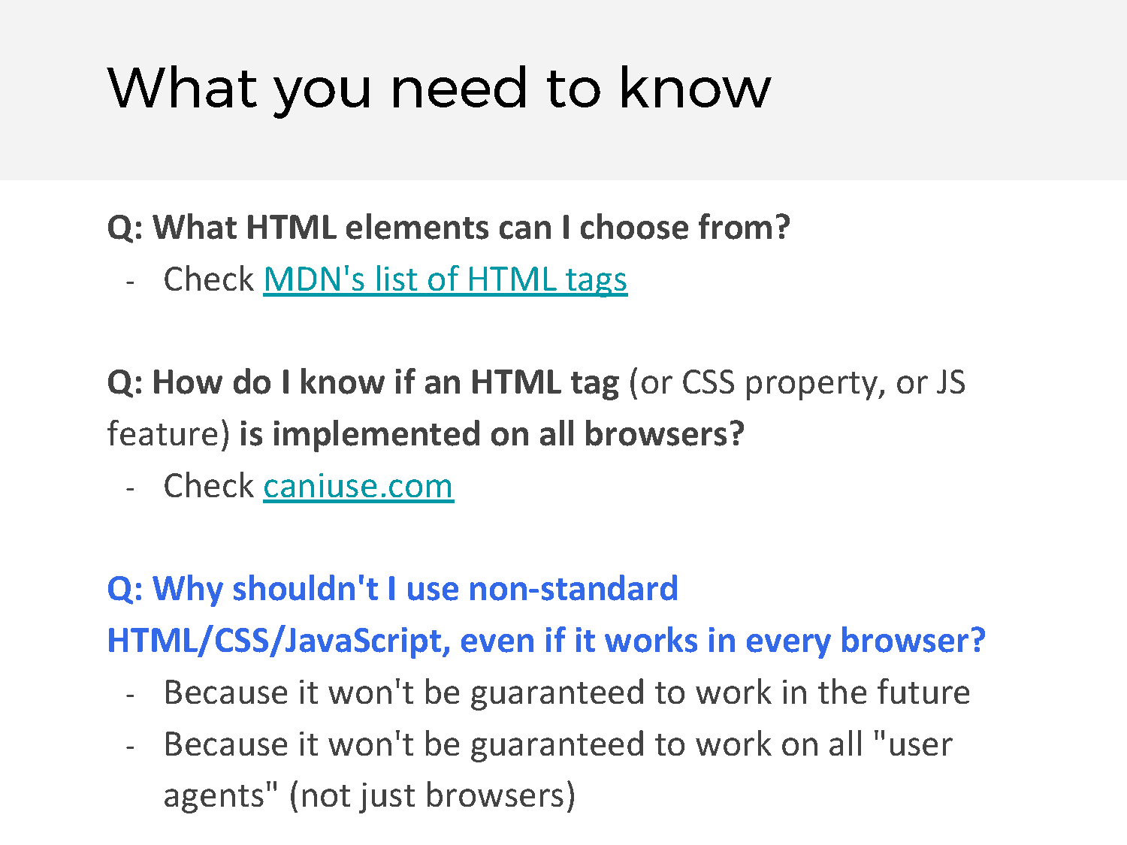

Slide 132
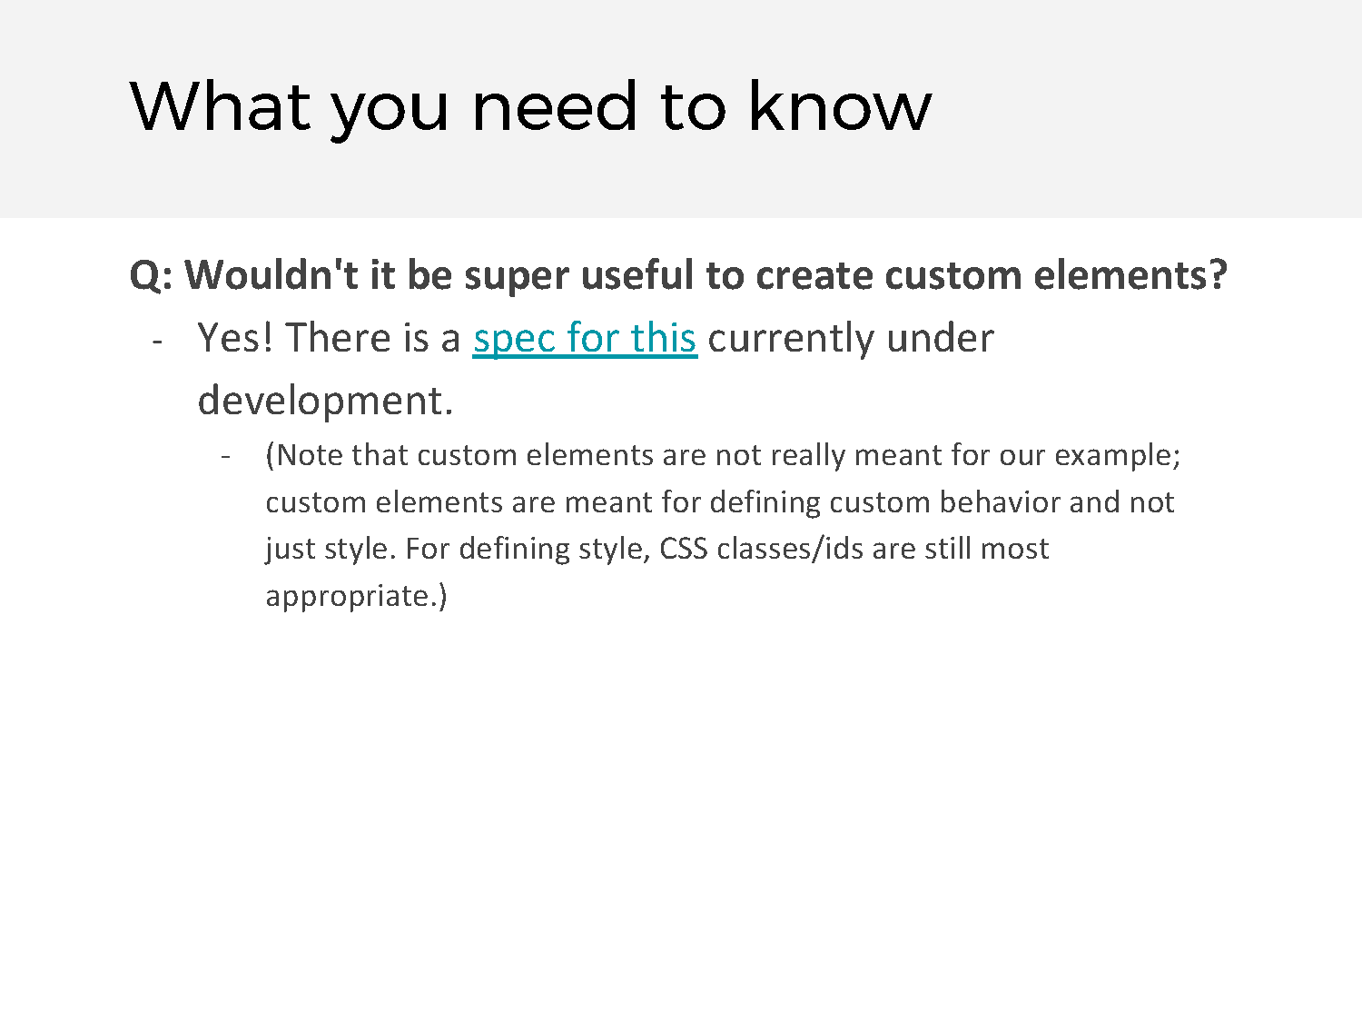
Notes:
Currently re

Slide 133
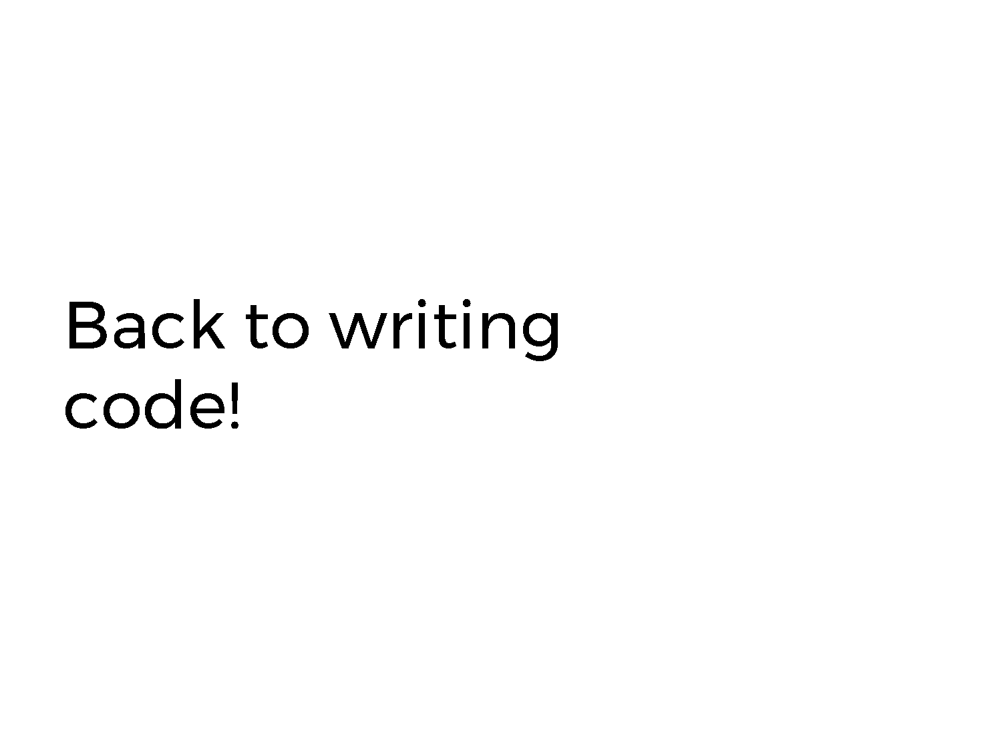

Slide 134
Video 14 – Selectors – Classes and Ids – Next time

Slide 135
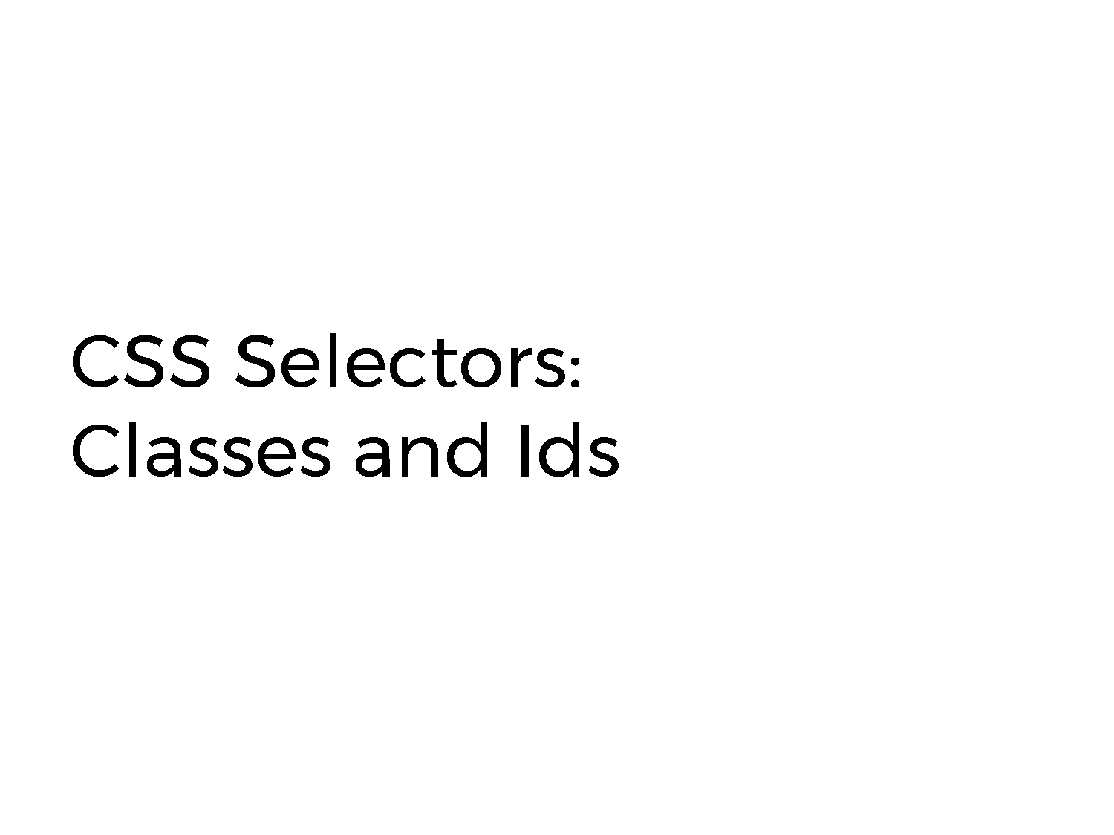

Slide 136
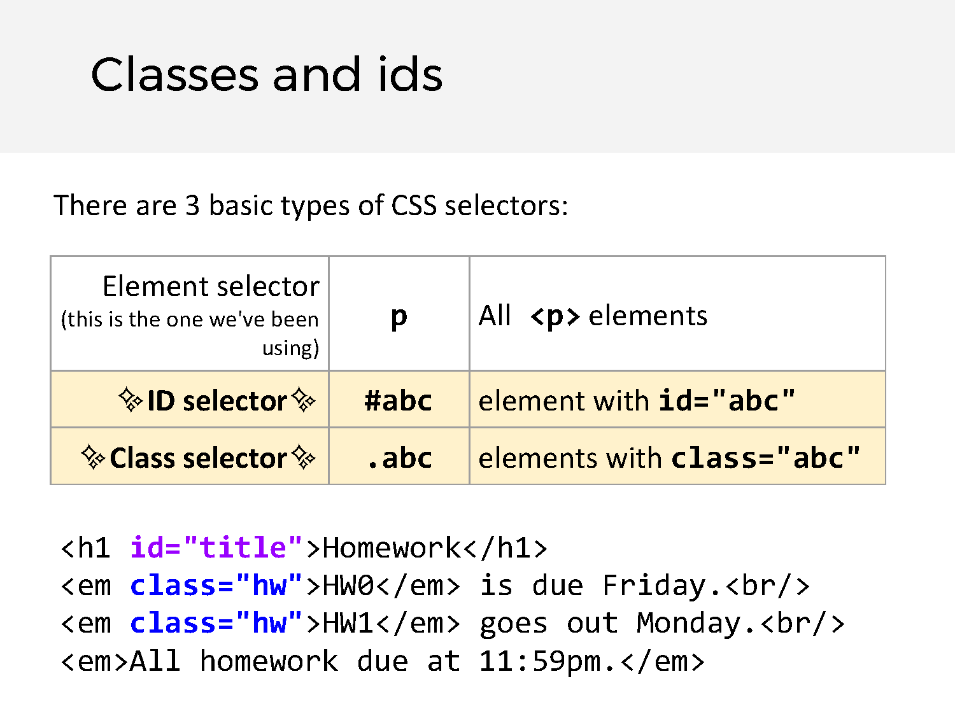

Slide 137


Slide 138
Video 15 – Other Selectors

Slide 139
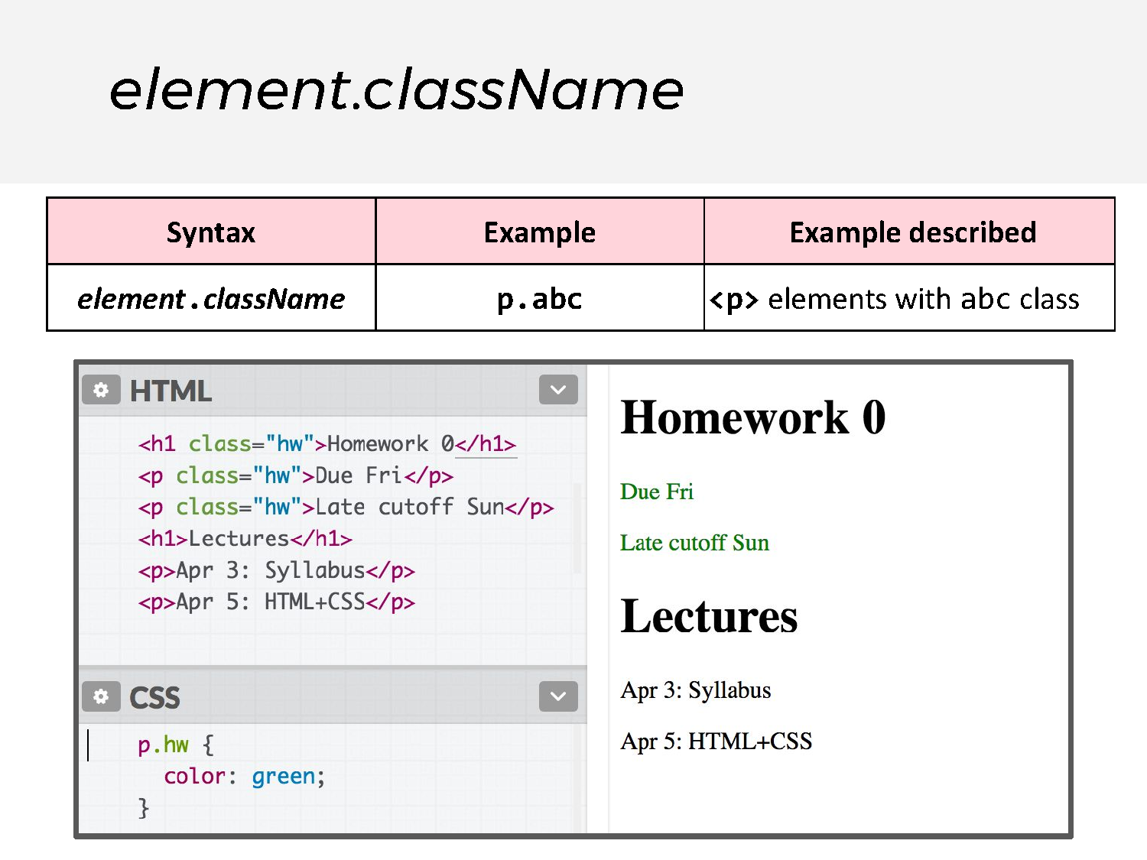

Slide 140
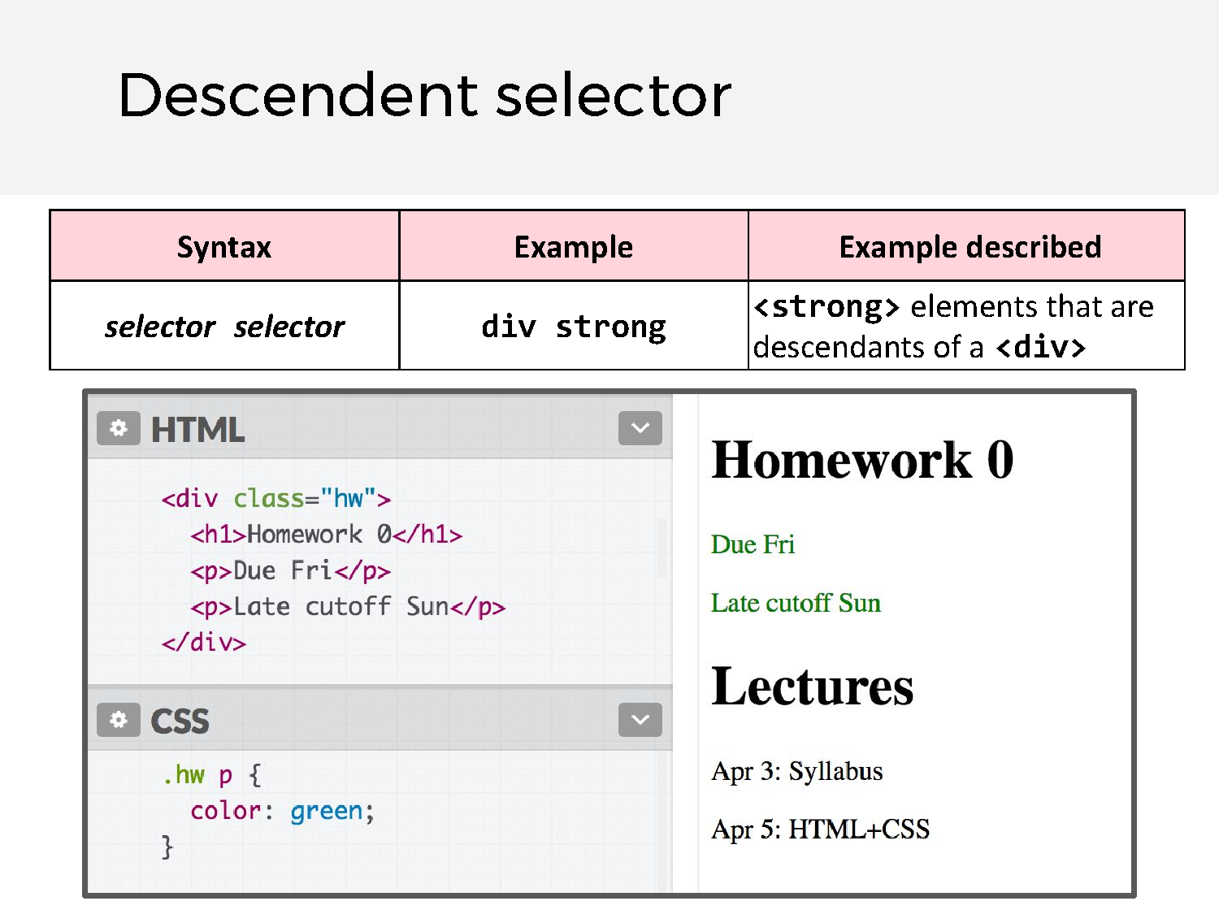

Slide 141
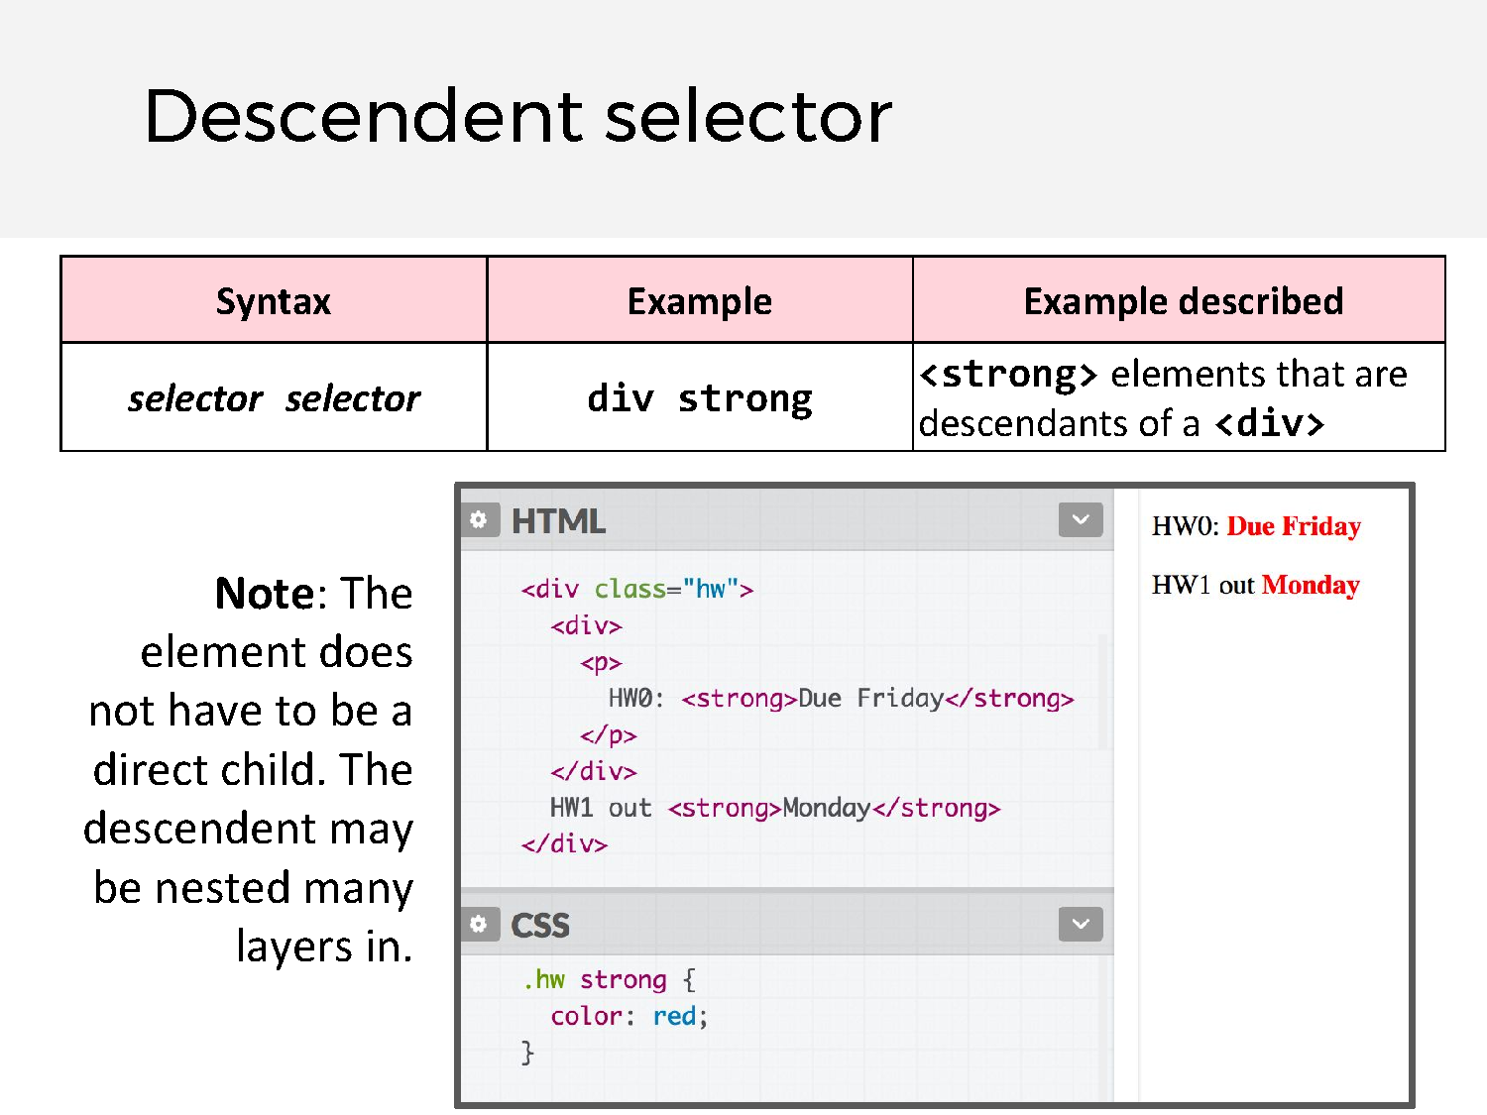

Slide 142
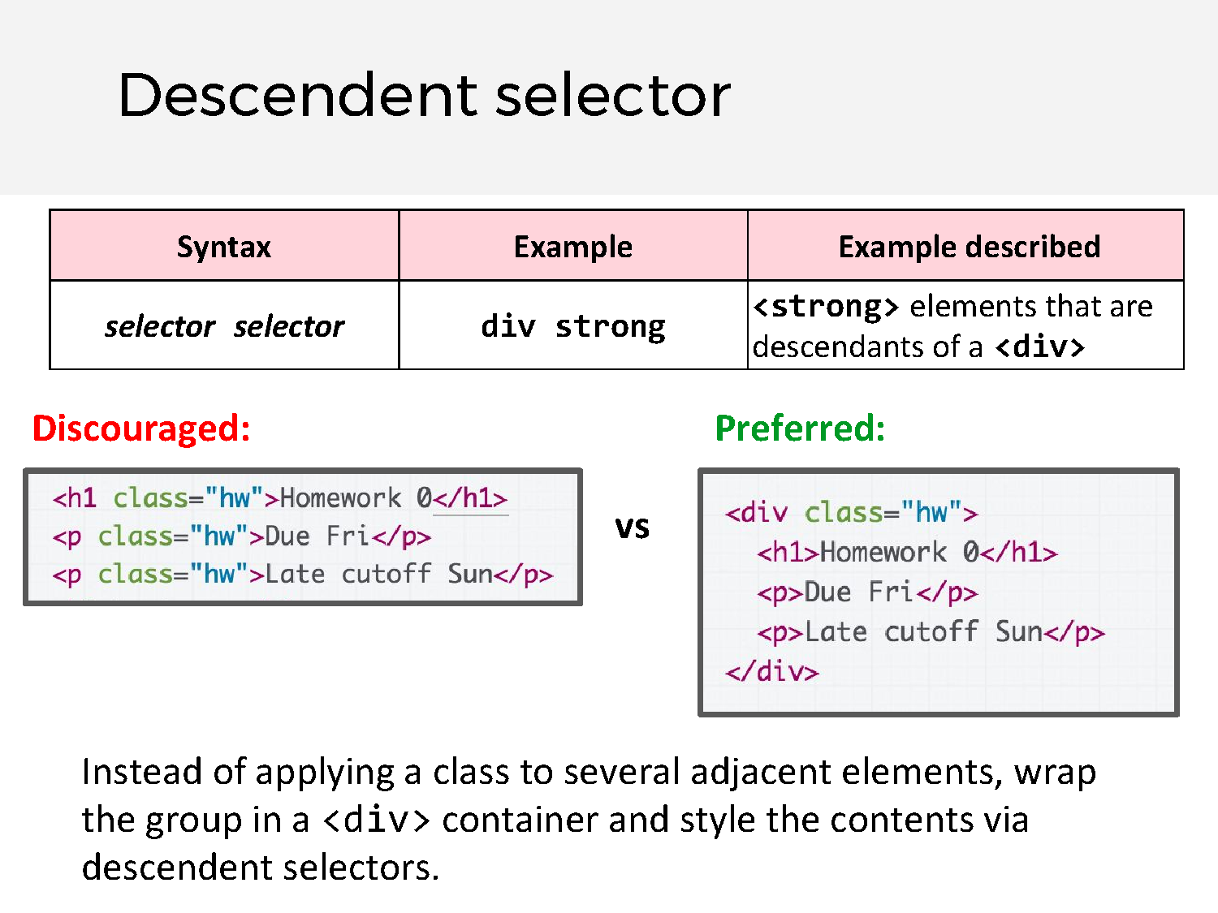

Slide 143


Slide 144


Slide 145
Pause

Slide 146
Video 16 – Grouping & Combining Selectors

Slide 147


Slide 148
Pause

Slide 149


Slide 150


Slide 151


Slide 152


Slide 153
Pause

Slide 154


Slide 155


Slide 156
Pause

Slide 157
Video 17 – Inheritance

Slide 158


Slide 159


Slide 160


Slide 161
Pause

Slide 162
Video 18 – Grouping & Combining Selectors

Slide 163


Slide 164


Slide 165


Slide 166


Slide 167
Pause

Slide 168


Slide 169
Pause

Slide 170


Slide 171


Slide 172
Video 19 – Why not Divs Everywhere

Slide 173
Answers

Slide 174
If you visit a (well designed) web page, you as the human reader can immediately (visually) distinguish all the page elements and more importantly understand the content. In the top left you see the company logo, next to it is the site navigation, there is a search bar and some text about the company, a link to a product you can buy and a legal disclaimer at the bottom.
However, machines are dumb and cannot do this:
Looking at the same page as you, all the web crawler would see is an image, a list of anchors tags, a text node, an input field and an image with a link on it. At the bottom there is another text node. Now, how should they know, what part of the document you intended to be the navigation or the main article, or some not-so-important footnote

Slide 175
Now imagine instead of a plain div, a nav element would be
used – the machine immediately knows what the purpose of this
element is:

Slide 176
Semantic tags are not the end.
There are things like metadata, ontologies, resource description
languages which go a step further and help connect data
between different web pages and can even help create
new knowledge!

Slide 177
Video 20 – CSS Box Model

Slide 178
Pause

Slide 179


Slide 180
CSS Box Model

Slide 181

The CSS Box Model
Every element is composed of 4 layers:
● the element's content
● the border around the element's content
● padding space between the content and border (inside)
● a margin clears the area around border (outside)

Slide 182
Pause

Slide 183



border
We've used the shorthand:
border: width style color;

Slide 184
border
Can also specify each border individually:
border-top border-bottom border-left border-right
And can set each property individually:
border-style: dotted; border-width: 3px; border-color: purple;
(all styles)

Slide 185
Pause

Slide 186
border
Can also specify each border individually:
border-top border-bottom border-left border-right
And can set each property individually:
border-style: dotted; border-width: 3px; border-color: purple;
(all styles)
There are other units besides pixels (px) but we will address them in the next couple lectures.

Slide 187


Rounded border
Can specify the border-radius to make rounded corners:
border-radius: 10px;
You don't actually need to set a border to use border-radius.

Slide 188
Pause

Slide 189


Borders look a little squished
When we add a border to an element, it sits flush against the text:
Q: How do we add space between the border and the content of the element?

Slide 190
Pause

Slide 191


padding
padding is the space between the border and the content.
- Can specify padding-top, padding-bottom, padding-left, padding-right
- There's also a shorthand:
padding: 2px 4px 3px 1px; <- top|right|bottom|left
padding: 10px 2px; <- top+bottom|left+right

Slide 192


<div>s look a little squished
When we add a border to multiple divs, they sit flush against each other:
Q: How do we add space between multiple elements?

Slide 193

margin
margin is the space between the border and other elements.
- Can specify margin-top, margin-bottom, margin-left, margin-right
- There's also a shorthand:
margin: 2px 4px 3px 1px; <- top|right|bottom|left
margin: 10px 2px; <- top+bottom|left+right

Slide 194
Pause

Slide 195


Slide 197
Next Time

Slide 198

margin
Actually, why doesn't this:
Look more like this?

Slide 199
margin
Actually, why doesn't this:
...look more like this?
20px margin-bottom
+
=
20px margin top
40px margin?

Slide 200

margin collapsing
Sometimes the top and bottom margins of block elements are combined ("collapsed") into a single margin.
- This is called margin collapsing
Generally if:
- The elements are siblings
- The elements are block-level (not inline-block)
then they collapse into max(Bottom Margin, Top Margin).
(There are some exceptions to this, but when in doubt, use the Page Inspector to see what's going on.)

Slide 201
Pause

Slide 202

Negative margin
Margins can be negative as well.
- No negative margin on image:

Slide 203

Negative margin
Margins can be negative as well. (CodePen)
- img { margin-top: -50px; }

Slide 204

auto margins
If you set margin-left and margin-right to auto, you can center a block-level element (CodePen):

Slide 205
Pause

Slide 206
Box model for inline elements?
Q: Does the box model apply to inline elements as well?

Slide 207



Box model for inline elements?
Q: Does the box model apply to inline elements as well? A: Yes, but the box is shaped differently.

Slide 208
Box model for inline elements?
Q: Does the box model apply to inline elements as well? A: Yes, but the box is shaped differently.
Let's change the line height to view this more clearly...

Slide 209
Pause

Slide 210



Inline element box model – Not Used
(Codepen)

Slide 211
Pause

Slide 212
Inline element box model
(Codepen)

Slide 213
Pause

Slide 214

Inline element box model – not used
- margin is to the left and right of the inline element
- margin-top and
margin-bottom are ignored
- use line-height to manage space between lines
(Codepen)

Slide 215
Pause

Slide 216

Inline element box model
- margin is to the left and right of the inline element
- margin-top and
margin-bottom are ignored
- use line-height to manage space between lines
(Codepen)

Slide 217
Pause

Slide 218

The CSS Box Model
Let's revisit our Course web page example:

Slide 219
Q: What does this look like in the browser?
div {
display: inline-block; background-color: yellow;
}
<body>
<div>
<p>Make the background color yellow!</p>
<p>Surrounding these paragraphs</p>
</div>
</body>

Slide 220

Q: Why is there a white space around the box?
We can use the browser's Page Inspector to help us figure it out!

Slide 221


body has a default margin
Set
body { margin: 0; }
to make your elements lay
flush to the page.

Slide 222
Recap so far...
We've talked about:
- block vs inline and the "natural" layout of the page, depending on the element type
- classes and ids and how to specify specific elements and groups of elements
- div and span and how to create generic elements
- The CSS box model and how every element is shaped like a box, with content -> padding -> border -> margin
Let's try making a "real" looking page!

Slide 223
Pause

Slide 224
Layout exercise

Slide 225

Squarespace template
Squarespace's most popular template looks like this:
Q: Do we know enough to make something like that?

Slide 226

Basic shape
Begin visualizing the layout in terms of boxes:

Slide 227
Basic shape
Begin visualizing the layout in terms of boxes:

Slide 228

Basic shape
Begin visualizing the layout in terms of boxes:
Let's first try making this layout!
Codepen Link

Slide 229
Content Sectioning elements
Name | Description
<p> | Paragraph (mdn)
<h1>-<h6> | Section headings (mdn)
<article> | A document, page, or site (mdn) This is usually a root container element after body.
<section> | Generic section of a document (mdn)
<header> | Introductory section of a document (mdn)
<footer> | Footer at end of a document or section (mdn)
<nav> | Navigational section (mdn)
These elements do not "do" anything; they are basically more descriptive
<div>s. Makes your HTML more readable. See MDN for more info.

Slide 230
Content Sectioning elements
Name | Description
<p> | Paragraph (mdn)
<h1>-<h6> | Section headings (mdn)
<article> | A document, page, or site (mdn) This is usually a root container element after body.
<section> | Generic section of a document (mdn)
<header> | Introductory section of a document (mdn)
<footer> | to <div> when it Footer at end of a document or section (mdn)
<nav> | Navigational section^{m}(mªdn^{k}) ^{es sense!}
Prefer these elements
These elements do not "do" anything; they are basically more descriptive
<div>s. Makes your HTML more readable. See MDN for more info.

Slide 231

Header
Navbar:
- Height: 75px
- Background: royalblue
- <nav>
Header:
- Height: 400px;
- Background: lightskyblue
- <header>

Slide 232
Main section
Gray box:
- Surrounding space: 75px above and below; 100px on each side
- Height: 500px
- Background: gray
- <section>

Slide 233

Footer
Footer:
- Height: 100px
- Background: Black
- <footer>

Slide 234
Main contents
Yellow paragraph:
- Height: 200px
- Background: khaki
- Space beneath: 75px
- <p>
Orange box:
- Height: 400px;
- Width: 48% of the parent's width, with space in between
- Background: tomato
- <div>

Slide 235
Main contents
Orange box:
- Height: 400px;
- Width: 48% of the parent's width, with space in between
- Background: tomato
- <div>
This is where we get stuck.

Slide 236
Pause

Slide 237
Flexbox

Slide 238
CSS layout so far
Block layout: Laying out large sections of a page
Inline layout: Laying out text and other inline content within a section

Slide 239
Flex layout
To achieve more complicated layouts, we can enable a different kind of CSS layout rendering mode: Flex layout.
Flex layout defines a special set of rules for laying out items in rows or columns.

Slide 240







Flex layout
Flex layout solves all sorts of problems.
- Here are some examples of layouts that are easy to create with flex layout (and really difficult otherwise):

Slide 241
Flex layout
But today we're only going to cover the basics
Flex layout solves all sorts of layout problems
- Here are some examples of layouts that are easy to create with flex layout (and really difficult otherwise):

Slide 242
Flex basics
Flex layouts are composed of:
- A Flex container, which contains one or more:
- Flex item(s)
You can then apply CSS properties on the flex container to dictate how the flex items are displayed.
id=flex-container
class= flex- item

Slide 243
Flex basics
To make an element a flex container, change display:
- Block container: display: flex; or
- Inline container: display: inline-flex;
Follow along in Codepen

Slide 245
(So far, this looks exactly the same as display: block)

Slide 246
Flex basics: justify-content
You can control where the item is horizontally* in the box by setting justify-content on the flex container:
#flex-container { display: flex;
justify-content: flex-start;
}
*when flex direction is row. We'll get to what "flex direction" means soon.

Slide 247
Flex basics: justify-content
You can control where the item is horizontally* in the box by setting justify-content on the flex container:
#flex-container { display: flex;
justify-content: flex-end;
}
*when flex direction is row. We'll get to what "flex direction" means soon.

Slide 248
Flex basics: justify-content
You can control where the item is horizontally* in the box by setting justify-content on the flex container:
#flex-container { display: flex;
justify-content: center;
}
*when flex direction is row. We'll get to what "flex direction" means soon.

Slide 249
Pause

Slide 250
Flex basics: align-items
You can control where the item is vertically* in the box by setting align-items on the flex container:
#flex-container { display: flex;
align-items: flex-start;
}
*when flex direction is row. We'll get to what "flex direction" means soon.

Slide 251
Flex basics: align-items
You can control where the item is vertically* in the box by setting align-items on the flex container:
#flex-container { display: flex;
align-items: flex-end;
}
*when flex direction is row. We'll get to what "flex direction" means soon.

Slide 252
Flex basics: align-items
You can control where the item is vertically* in the box by setting align-items on the flex container:
#flex-container { display: flex;
align-items: center;
}
*when flex direction is row. We'll get to what "flex direction" means soon.

Slide 253
Pause

Slide 254
Multiple items
Same rules apply with multiple flex items:
#flex-container { display: flex;
justify-content: flex-start; align-items: center;
}

Slide 255
Multiple items
Same rules apply with multiple flex items:
#flex-container { display: flex;
justify-content: flex-end; align-items: center;
}

Slide 256
Multiple items
Same rules apply with multiple flex items:
#flex-container { display: flex;
Justify-content: center; align-items: center;
}

Slide 257
Multiple items
And there is also space-between and space-around:
#flex-container { display: flex;
Justify-content: space-between; align-items: center;
}

Slide 258
Multiple items
And there is also space-between and space-around:
#flex-container { display: flex;
Justify-content: space-around; align-items: center;
}

Slide 259
Pause

Slide 260
flex-direction
And you can also lay out columns instead of rows:
#flex-container { display: flex;
flex-direction: column;
}

Slide 261
flex-direction
And you can also lay out columns instead of rows:
#flex-container { display: flex;
flex-direction: column;
justify-content: center;
}
Now justify-content controls where the column is vertically in the box

Slide 262
flex-direction
And you can also lay out columns instead of rows:
#flex-container { display: flex;
flex-direction: column;
justify-content: space-around;
}
Now justify-content controls where the column is vertically in the box

Slide 263
flex-direction
And you can also lay out columns instead of rows:
#flex-container { display: flex;
flex-direction: column;
align-items: center;
}
Now align-items controls where the column is horizontally in the box

Slide 264
flex-direction
And you can also lay out columns instead of rows:
#flex-container { display: flex;
flex-direction: column;
align-items: flex-end;
}
Now align-items controls where the column is horizontally in the box

Slide 265
Before we move on…

Slide 266

What happens if the flex item is an inline element?

Slide 267

???

Slide 268

Recall: block layouts
If #flex-container was not display: flex:
Then the span flex-items would not show up because span
elements are inline, which don't have a height and width

Slide 269
Flex layouts
Why does this change when display: flex?
Why do inline elements suddenly seem to have height and width?

Slide 270
More next time!

Slide 271


Slide 272
INCASE - HTML and CSS

Slide 273
HTML and CSS strategy
Assumption: Most people have cursory familiarity with HTML and CSS. Therefore we will:
Speed through the obvious stuff
Skip self-explanatory syntax
Skip the parts you can look up easily through Google
Therefore, be aggressive with questions!

Slide 274
Pause

Slide 275
Today's schedule
Today
- Squarespace Layout
- Single row/column flexbox
- vh / vw / box-sizing
Friday
- position
- Random helpful CSS
- Mobile layouts
- CSS wrap-up
Monday
- Intro to JavaScript

Slide 276
Mistake on padding/margin
The shorthand for padding and margin actually go clockwise, not counter-clockwise (which...makes more sense)
padding: 2px 4px 3px 1px; <- top|right|bottom|left
margin: 2px 4px 3px 1px; <- top|right|bottom|left
(Previous slides now fixed)

Slide 277
Font-related CSS review
Name | Description
font-family | Font face (mdn)
color | Font color (and always font color) (mdn)
font-size | Font size (mdn)
line-height | Line height (mdn)
text-align | Alignment of text (mdn)

Slide 278
More font-related CSS
Name | Description
text-decoration | Can set underline, line-through (strikethrough) or none (e.g. to unset underline on hyperlinks) (mdn)
text-transform | Can change font case, i.e. uppercase, lowercase, capitalize, none (mdn)
font-style | Can set to italic or normal (e.g. to unset italic on <em>) (mdn)
font-weight | Can set to bold or normal (e.g. to unset bold on h1 - h6) (mdn)
letter-spacing | Controls the space between letters (mdn)

Slide 279
Flexbox

Slide 280

Review: Flexbox
How do we create this look? (Codepen)

Slide 281

Review: Flexbox
How do we create this look? (Codepen)

Slide 282
Pause

Slide 283
Continuing where we left off!

Slide 284
Goal
We were trying to create a layout that looks sort
of like this:

Slide 285
Status
We broke up the layout into a bunch of colored
boxes:
And we got kind of stuck trying to position the
orange boxes.

Slide 286
Pause

Slide 287
Review this

Slide 288
What happens if the flex item is an inline element?

Slide 289
???

Slide 290
Flex layouts
Why does this change when display: flex?
Why do inline elements suddenly seem to have height and width?

Slide 291
More next time!

Slide 292
Pause

Slide 293
Recall: block layouts
If #flex-container was not display: flex:
Then the span flex-items would not show up because span
elements are inline, which don't have a height and width

Slide 294
(Review block and inline!)
(Please make sure you completely understand why the <span>
elements do not show up!)
Check out block vs inline guide

Slide 295
Pause

Slide 296
What happens if the flex item is an inline element?

Slide 297
Pause

Slide 298
???

Slide 299
Pause

Slide 300
Recall: block layouts
If #flex-container was not display: flex:
Then the span flex-items would not show up because span
elements are inline, which don't have a height and width

Slide 301
Flex layouts
Why does this change when display: flex?
Why do inline elements suddenly seem to have height and width?

Slide 302
Flex: A different rendering mode
- When you set a container to display: flex, the direct children in that container are flex items and follow a new set of rules.
- Flex items are not block or inline; they have different rules for their height, width, and layout.
- The contents of a flex item follow the usual block/inline rules, relative to the flex item's boundary.
- The height and width of flex items are… complicated.
Follow along on CodePen

Slide 303
Flex item sizing

Slide 304
Flex basis
Flex items have an initial width*, which, by default is either:
- The content width, or
- The explicitly set width property of the element, or
- The explicitly set flex-basis property of the element
This initial width* of the flex item is called the flex basis.
*width in the case of rows; height in
the case of columns

Slide 305
Flex basis
Flex items have an initial width*, which, by default is either:
- The content width, or
- The explicitly set width property of the element, or
- The explicitly set flex-basis property of the element
This initial width* of the flex item is called the flex basis.
The explicit width* of a flex item is respected for all flex items, regardless of whether the flex item is inline, block, or
inline-block.
*width in the case of rows; height in
the case of columns

Slide 306

Flex basis
If we unset the height and width, our flex items disappears, because the flex basis is now the content size, which is empty:

Slide 307
flex-shrink
The width* of the flex item can automatically shrink smaller than the flex basis via the flex-shrink property:
flex-shrink:
- If set to 1, the flex item shrinks itself as small as it can in the space available.
- If set to 0, the flex item does not shrink.
Flex items have flex-shrink: 1 by default.
*width in the case of rows; height in
the case of columns

Slide 308



The flex items' widths all shrink to fit within the container.

Slide 309


Setting flex-shrink: 0; undoes the shrinking behavior, and the flex items do not shrink in any circumstance:

Slide 310
flex-grow
The width* of the flex item can automatically grow larger than the flex basis via the flex-grow property:
flex-grow:
- If set to 1, the flex item grows itself as large as it can in the space remaining.
- If set to 0, the flex-item does not grow.
Flex items have flex-grow: 0 by default.
*width in the case of rows; height in
the case of columns

Slide 311
flex-grow example
Let's unset the height and width of our flex items again:

Slide 312

flex-grow example
If we set flex-grow: 1, the flex items fill the empty space:

Slide 313
Flex item height**?!
Note that flex-grow
only controls width*.
So why does the height** of the flex items seem to "grow" as well?
*width in the case of rows; height in
the case of columns
**height in the case of rows; width in
the case of columns

Slide 314
align-items: stretch;
The default value of align-items is stretch, which means every flex item grows vertically* to fill the container by default.
(This will not happen if the height on the flex item is set)
*vertically in the case of rows; horizontally in the case of columns

Slide 315

align-items: stretch;
If we set another value for align-items, the flex items disappear again because the height is now content height, which is 0:

Slide 316
Flex layout recap
- If you set display: flex, the element is now a flex container and its direct children are flex items.
- The items in a flex container will layout in a row or column depending on the flex-direction of the container.

Slide 317
Flex layout recap
- justify-contents distributes the items horizontally for flex-direction: row, vertically for column
- align-items distributes the items vertically for
flex-direction: row, horizontally for column

Slide 318
Flex layout recap
For flex-direction: row:
- The flex basis is the initial width of a flex item
- This is either the explicitly set width, the explicitly set flex-basis, or the content width
- The width of a flex item will shrink to fit the container if
flex-shrink is set to 1 (disabled if 0)
- The width of a flex item will grow to fit the remaining space if flex-grow is set to 1 (disabled if 0)

Slide 319
Flex layout recap
For flex-direction: row:
- The height of a flex item is either:
- the explicitly set height on the item, or
- the content height on the item, or
- the height of the container if the container's
align-items: stretch;

Slide 320
Flex layout recap
For flex-direction: column:
- The flex basis is the initial height of a flex item
- This is either the explicitly set height, the explicitly set flex-basis, or the content height
- The height of a flex item will shrink to fit the container if flex-shrink is set to 1 (disabled if 0)
- The height of a flex item will grow to fit the remaining space if flex-grow is set to 1 (disabled if 0)

Slide 321
Flex layout recap
For flex-direction: column:
- The width of a flex item is either:
- the explicitly set width on the item, or
- the content width on the item, or
- the width of the container if the container's align-items: stretch;

Slide 322
That's still just scratching the surface of flex box...

Slide 323
...but we now know enough to continue our layout!
Follow along on Codepen

Slide 324
Pause

Slide 325
Height and width quirks:
vh, vw, box-sizing

Slide 326



Flexbox example
How do we make a layout that looks like this? (Codepen)
The header and footer stay at the top and bottom of the viewport. (Live example)

Slide 327
height and width percentages
When width is defined as a percentage:
- width is specified as a percentage of the containing block's width.
When height is defined as a percentage:
- height is specified as a percentage of the containing block's height.
In other words, height and width are defined relative to their parent element when defined as a percentage.

Slide 328




height and width percentages
HTML
OUTPUT
CSS
(Codepen)

Slide 329

Viewport?
Browser vocabulary:
- viewport: the rectangle where the webpage shows up, scrollable via a scrollbar
- chrome: all the UI that's not the webpage, i.e. everything but the viewport

Slide 330
Viewport?
Browser vocabulary:
- viewport: the rectangle where the webpage shows up, scrollable via a scrollbar
- chrome: all the UI that's not the webpage, i.e. everything but the viewport
The viewport

Slide 331
Viewport?
Browser vocabulary:
- viewport: the rectangle where the webpage shows up, scrollable via a scrollbar
- chrome: all the UI that's not the webpage, i.e. everything but the viewport
The chrome

Slide 332
vh and vw
You can define height and width in terms of the viewport
- Use units vh and vw to set height and width to the percentage of the viewport's height and width, respectively (mdn)
- 1vh = 1/100th of the viewport height
- 1vw = 1/100th of the viewport width
Example:
- height: 100vh;
- width: 100vw;

Slide 333



Flexbox example, solved
HTML
Web Dev is Fun
August 2021
CSS
(CodePen)
(rest of the CSS)

Slide 334

Aside: sizing
Q: What happens if we add a border to #upper-half?
(rest of the css)

Slide 335


???
(rest of the CSS)

Slide 336
CSS box model width and height
The box model defines CSS width and height properties to refer to the element's content width and height:

Slide 337
box-sizing
If you want to have width and height refer to the element's border width and height, use box-sizing:
- box-sizing: border-box;
Note: Using border-box will include padding in the width and height as well. Note: You cannot select padding-box or margin-box.

Slide 338


Fixed example
(rest of the CSS)

Slide 339
Before we finish Squarespace...

Slide 340
Another rendering mode: position
Next time!

Slide 341
Today's schedule
Today
- position
- Random helpful CSS
- calc, variables, background properties
- Mobile layouts
- em and rem
Monday
- Intro to JavaScript

Slide 342
"I can think of 12 different ways to implement this!
Which one is best?"

Slide 343
Simplicity above all else
Always prefer simplicity.
Other tips:
- Separation of concerns: HTML should contain content NOT style, CSS should contain style NOT content
- Descriptive HTML tags: Make your HTML more readable by using e.g. <header> instead of <div> when appropriate
- Reduce redundancy: Try grouping styles, using descendant selectors to reduce redundancy (see past slides for details)

Slide 344
Last time
More flexbox stuff:
- flex-shrink
- Default value is 1 (on by default)
- This CSS property is on the flex item, not container
- flex-grow
- Default value is 0 (off by default)
- This CSS property is on the flex item, not container
vh / vw / box-sizing

Slide 345


Flexbox example
How do we make a layout that looks like this? (Codepen)
The header and footer stay at the top and bottom of the viewport. (Live example)

Slide 346
Flexbox example
How do we make a layout that looks like this? (Codepen)
The header and footer stay at the top and bottom of the viewport. (Live example)

Slide 347


Flexbox example solution
(Solved CodePen)

Slide 348
Another rendering mode: position

Slide 349
Moving things with position
Positioned layout lets you define precisely where an element should be in the page (mdn).
You can use positioned layout doing the following:
1. Define a position method:
Static, fixed, absolute, relative
2. Define offsets: top, left, bottom, and right
3. (optional) Define z-index for overlapping layers (mdn)
Let's check it out!

Slide 350
Moving things with position
To specify exactly where an element goes, set
its top, left, bottom, and/or right offset.
The meaning of these offset values depend on the reference point set by position:
- static: no reference point; static block can't move
(this is the default style for every element)
- fixed: a fixed position within the viewport
- absolute: a fixed position within its "containing element"
- relative: offset from its normal static position

Slide 351



position: static
(nothing happens!)
- static is the default value for position
- If you use top / left / bottom / right without setting a non-static position, nothing will happen
(CodePen)

Slide 352


position: fixed
#menubar { position: fixed; top: 50px; right: 100px;
}
- For fixed positioning, the offset is the distance positioned relative to the viewport.
- The element does not move when scrolled.
- Element is removed from normal document flow, positioned on its own layer
50px
100px
Often used to implement UIs; control bars that shouldn't go away

Slide 353


position: fixed
(CodePen)

Slide 354


position: absolute
#menubar {
position: absolute; left: 400px;
top: 50px;
}
50px
400px
- For absolute positioning, the offset is the distance from the "containing element", which is the viewport by default
- Element is removed from normal document flow, positioned on its own layer

Slide 355


position: absolute
(CodePen)

Slide 356


position: relative
For position: relative; the element is placed where it would normally be placed in the layout of the page, but shifted by the top / left / bottom / right values.
(CodePen)

Slide 357
Relative absolute positioning
Let's revisit the definition of absolute positioning:
- absolute: a fixed position within its "containing element"
- The containing element is the viewport by default
You can change the containing element by setting "position: relative;" on some parent of your absolutely positioned element!

Slide 358


Relative absolute positioning
#area2 {
position: relative;
}
50px
#menubar {
position: absolute; left: 400px;
top: 50px;
}
300px
Offsets are relative to the first parent element that has
position: relative which in this case is #area2

Slide 359



Common use case: Overlay
(CodePen)

Slide 360
Let's revisit Squarespace again! (link to solution)

Slide 361
Random useful CSS

Slide 362
calc
You can use the calc CSS function to define numeric values in terms of expressions:
width: calc(50% - 10px); width: calc(100% / 6);
(MDN details of calc)

Slide 363
CSS variables
Variables are a brand-new CSS feature (caniuse).
:root {
--primary-color: hotpink;
}
h1 {
background-color: var(--primary-color);
}
(MDN details of CSS variables)

Slide 364

background properties
An easy way to render images stretched and cropped to a given size: set it as a background image for an element.
background-image: url(background.png);
(CodePen)

Slide 365
background properties
You can then use additional background properties to further style it:
background-size: cover; background-size: contain; background-repeat: no-repeat; background-position: top; background-position: center;
(CodePen: Try resizing the window)

Slide 366

Web Fonts
You can use Google Fonts to choose from better fonts:

Slide 367

Web Fonts
You can use Google Fonts to choose from better fonts:
The instructions are pretty self-explanatory:
Basically, add the given
<link> tag into the
<head> section of your page alongside your other CSS files.

Slide 368

Aside: Fallback fonts
Notice that the Google Font example shows a comma-separated list of values for font-family:
- Each successive font listed is a fallback, i.e. the font that will be loaded if the previous font could not be loaded
- There are also six generic font names, which allows the browser to choose the font based on intent + fonts available on the OS.
- It's good practice to list a generic font at the end of all your
font-family declarations.

Slide 369



Hosted fonts with @font-face
You can also load your own font via @font-face:
- Give it your own font name
- Link to where the font file is found
CodePen

Slide 370
Tomorrow -Continue

Slide 371
Mobile web

Slide 372

Say you have the following website:
Q: What does it look like on a phone?

Slide 373



Not terrible… but pretty small and hard to read.

Slide 374
Responsive web design
We want to write our CSS in a way that can look nice in a wide range of screen sizes:
- 27" desktop monitor
- Macbook Air
- Samsung Galaxy S7
- iPhone 7
- iPad
Q: How do we do this?
Do we need to write totally different CSS for every screen size?!

Slide 375
Mobile sizing
Unless directed otherwise via HTML or CSS cues, mobile browsers render web pages at a desktop screen width (~1000px), then "zooms out" until the entire page fits on screen.
(That's why you sometimes get web pages with teeny-tiny font on your phone: these webpages have not added support for mobile.)
(Read more on how this works)

Slide 376
Meta viewport tag
To prevent phone browsers from rendering the page at
desktop width and zooming out, use the meta viewport tag:
<meta name="viewport" content="width=device-width, initial-scale=1">
This belongs in the <head> section of your HTML.
(Same section as the <title>, <link>, and other metadata elements.)

Slide 377


Meta viewport tag
Without the meta viewport tag
With the meta viewport tag

Slide 378
Meta viewport tag
<meta name="viewport" content="width=device-width, initial-scale=1">
- name=viewport: "Browser, I am going to tell you how I want the viewport to look."
- width=device-width: "The viewport's width should
always start at the device's width." (i.e., don't do that thing on mobile where you render the page at the desktop's width)
- initial-scale=1: "Start at zoom level of 100%."

Slide 379
Meta viewport tag
<meta name="viewport" content="width=device-width, initial-scale=1">
(You should pretty much always include this tag in your HTML.)

Slide 380
Making adjustments
The meta viewport tag gets us almost all the way there, but we want to make a few adjustments.
For example, the margin seems a tad too big on mobile. Can we set a different margin property for mobile?

Slide 381

CSS media queries
You can define a CSS media query in order to change style rules based on the characteristics of the device:
@media (max-width: 500px) {
article { margin: 0 2px;
}
}
You can create much more complex media queries as well.

Slide 382
Development strategies
Practical question: How do you test mobile layouts?
- Do you upload your HTML+CSS somewhere online and navigate to that URL on your phone?
- Is there a way to connect your phone to your local device?
- Do you run it in an Android/iOS emulator?
- Other?!

Slide 383

Chrome device mode
You can simulate a web page in a mobile layout via Chrome device mode:

Slide 384
Chrome device mode
You can simulate a web page in a mobile layout via Chrome device mode:

Slide 385

Chrome device mode
You can simulate a web page in a mobile layout via Chrome device mode:

Slide 386
Chrome device mode
Advantages of Chrome device mode:
- Super convenient
- Mostly accurate
Disadvantages of Chrome device mode:
- Not always accurate - iPhone particularly an issue
- A little buggy
- Doesn't simulate performance issues
You should always test on real devices, too.

Slide 387

Chrome remote debugging
If you have an Android phone, you can debug web pages on your phone via Chrome remote debugging.
(You can also load a server running locally on your laptop, on your phone via port forwarding.
But we haven't talked about servers yet.)

Slide 388

Safari remote debugging
If you have an iPhone, you can debug web pages on your phone via Safari remote debugging.

Slide 389
Code Mobile Responsivess

Slide 390
Relative font sizes: percent, em, rem

Slide 391
Relative units
Whenever possible, it's best to use relative units (like percentage) instead of absolute units (like px).
Advantages:
- More likely to work on different screen sizes
- Easier to reason about; fewer magic numbers
10% / 80% / 10% vs 122px / 926px / 122px
Q: Should we be using relative units on font-size?

Slide 392



Relative font sizes: percent
You can define font sizes in terms of percentage:
(CodePen)

Slide 393



Relative font sizes: percent
Percent on font-size behaves exactly like percentage on width and height, in that it's relative to the parent:
(CodePen)

Slide 394
Relative font sizes: percent
Percent on font-size behaves exactly like percentage on width and height, in that it's relative to the parent:
p is 75% of its parent, which is 200% of 30px.
p's size: .75*2*30 = 45px
(CodePen)

Slide 395
Relative font sizes: em
But instead of percentages, relative font sizes are usually defined in terms of em:
- em represents the calculated font-size of the element
- 1em = the inherited font size
- 2em = 2 times the inherited font size
In other words,
font-size: 1em; is the same as font-size: 100%;

Slide 396

Relative font sizes: em
(CodePen)

Slide 397

Relative font sizes: em
(CodePen)

Slide 398
Relative font sizes: em
p's inherited font size is 2em, which is 60px. So 0.75em is 0.75*60 = 45px.
(CodePen)

Slide 399



Wait, why is <strong> 120px and not 60px?

Slide 400


(CodePen)
In the Chrome Inspector, we see the default browser
font-size for h1 is 2em. So it's 30*2*2 = 120px.

Slide 401
Relative font sizes: rem
If you do not want your relative font sizes to compound through inheritance, use rem:
- rem represents the font-size of the root element
- 1rem = the root (html tag) font size
- 2rem = 2 times root font size

Slide 402



Relative font sizes: rem
(CodePen)

Slide 403
Relative font sizes: rem
font-size is set on the html element, not body (or any other tag)
(CodePen)

Slide 404
Relative font sizes: rem
.75em is calculated from the root, which is 30px, so 30*.75 = 22.5px.
(CodePen)

Slide 405
Relative font conclusions
Use relative fonts for the same purpose as using relative heights and widths:
- Prefer em and rem over percentages
- Not for any deep reason, but em is meant for font so it's semantically cleaner
- Use rem to avoid compounding sizes
- In addition to font-size, consider em/rem for:
- line-height
- margin-top
- margin-bottom

Slide 406


What does our Squarespace layout look like in a phone with the meta viewport tag?

Slide 407




Without the meta viewport tag
With the meta viewport tag

Slide 408
Continue Coding

Slide 409



Completed mobile layout

Slide 410
Mobile summary
- Always add the meta viewport tag
- Use @media queries to add styles for devices with certain characteristics, such as screen width
- Use the Chrome Device Mode to simulate mobile rendering on desktop
- For height and width, prefer percentages
- For fonts, prefer em and rem
- Try to minimize dependent rules (Changing the width of one container force you to change 15 other properties to look right)
More on responsive web design

Slide 411
CSS wrap-up
Even though we're "done" with CSS, we will be using CSS all quarter in homework and examples.
Later this quarter:
- More flexbox patterns
- More practice with flexbox / game
- CSS animations
- Possibly grid

Slide 412
CSS wrap-up
Even though we're "done" with CSS, we will be using CSS all quarter in homework and examples.
- More flexbox patterns
- More practice with flexbox / game
- CSS animations
- Possibly grid
SVGs
https://codepen.io/noeldelgado/pen/ByxQjL

Slide 413
Advanced CSS

Slide 414
Module 3 - JS

Slide 415
Today's schedule
Today
- Intro to Amateur JavaScript
- What is JavaScript?
- Tour of language features
- Basic event handling

Slide 416
How do web pages work again?

Slide 417

You are on your laptop

Slide 418


Your laptop is running a web browser, e.g.
Chrome

Slide 419

You type a URL in the address bar and hit "enter"
http://hiveacademy.co

Slide 420



(Warning: Somewhat inaccurate, massive hand-waving begins now.
See this Quora answer for slightly more detailed/accurate handwaving)

Slide 421


Server at http://hiveacademy.co
Browser sends an HTTP request saying "Please GET me the index.html file at http://hiveacademy.co"
(Routing, etc…)

Slide 422


Server at http://hiveacademy.co
Assuming all goes well, the server responds by sending the HTML file through the internet back to the browser to display.

Slide 423


Server at http://hiveacademy.co
The HTML will include things like
<img src="pup.png" /> and
<link src="style.css" .../> which generate more requests for those resources

Slide 424


Server at http://hiveacademy.co
And the server replies with those resources for the browser to render

Slide 425

Finally, when all resources are loaded, we see the loaded web page
http://hiveacademy.co

Slide 426
+
produces
Describes the content and structure of the page
Describes the
appearance and style of the page
A web page… that doesn't do anything

Slide 427


What we've learned so far
We've learned how to build web pages that:
- Look the way we want them to
- Can link to other web pages
- Display differently on different screen sizes
But we don't know how build web pages that do anything:
- Get user input
- Save user input
- Show and hide elements when the user interacts with the page
- etc.

Slide 428
What we've learned so far
We've learned how to build web pages that:
- Look the way we want them to
- Can link to other web pages
- Display differently on different screen sizes
But we don't know how build web pages that do anything:
- Get user input
- Save user input
- Show and hide elements when the user interacts with the page
- etc.
Enter JavaScript!

Slide 429
Pause

Slide 430
JavaScript

Slide 431

JavaScript
JavaScript is a programming language.
It is currently the only programming language that your browser can execute natively. (There are efforts to change that.)
Therefore if you want to make your web pages do stuff, you must use JavaScript: There are no other options.

Slide 432
JavaScript
- Created in 1995 by Brendan Eich
(co-founder of Mozilla; resigned 2014 due to his homophobia)
- JavaScript has nothing to do with Java
- Literally named that way for marketing reasons
- The first version was written in 10 days
- Several fundamental language decisions were made because of company politics and not technical reasons
"I was under marketing orders to make it look like Java but not make it too big for its britches ... [it] needed to be a silly little brother language." (source)

Slide 433
JavaScript
- Created in 1995 by Brendan Eich
(co-founder of Mozilla; resigned 2014 due to his homophobia)
- JavaScript has nothing to do with Java
- Literally named that way for marketing reasons
- The first version was written in 10 days
- Several fundamental language decisions were made because of company politics and not technical reasons
In other words:
JavaScript is messy and full of drama… and our only option.
(though it's gotten much, much better in the last few years)

Slide 434

Our JavaScript Strategy
This section: "Amateur JavaScript"
- Simple, old-school JavaScript
- Mostly not best practice
- Everything in global scope
- No classes / modules
- Will result in a big mess if you code this way for anything but very small projects
- (But easy to get started)
Other Sections(?): Modern JavaScript
- More disciplined and based on best practices
- Even more "opinionated"

Slide 435
Pause

Slide 436
JavaScript
in the browser

Slide 437
Code in web pages
HTML can embed JavaScript files into the web page via the
<script> tag.
<!DOCTYPE html>
<html>
<head>
<title>CS 193X</title>
<link rel="stylesheet" href="style.css" />
<script src="filename.js"></script>
</head>
<body>
... contents of the page...
</body>
</html>

Slide 438
console.log
You can print log messages in JavaScript by calling
console.log():
script.js
console.log('Hello, world!');
This JavaScript's equivalent of Java's
System.out.println, print, printf, etc.

Slide 439
How does JavaScript get loaded?

Slide 440

<head>
<title>Web Dev</title>
<link rel="stylesheet" href="style.css" />
<script src="script.js"></script>
</head>
The browser is parsing the HTML file, and gets to a script tag, so it knows it needs to get the script file as well.

Slide 441
<head>
<title>Web Dev</title>
<link rel="stylesheet" href="style.css" />
<script src="script.js"></script>
</head>
The browser makes a request to the server for the script.js file, just like it would for a CSS file or an image...

Slide 442
<head>
<title>Web Dev</title>
<link rel="stylesheet" href="style.css" />
<script src="script.js"></script>
</head>
And the server responds with the JavaScript file, just like it would with a CSS file or an image...

Slide 443
<head>
<title>Web Dev</title>
<link rel="stylesheet" href="style.css" />
<script src="script.js"></script>
</head>
console.log('Hello, world!');
Now at this point, the JavaScript file will execute "client-side", or in the browser on the user's computer.

Slide 444
JavaScript execution
There is no "main method"
- The script file is executed from top to bottom.
There's no compilation by the developer
- JavaScript is compiled and executed on the fly by the browser
(Note that this is slightly different than being "interpreted": see just-in-time (JIT) compilation)

Slide 445
first-js.html
<!DOCTYPE html>
<html>
<head>
<meta charset="utf-8">
<title>First JS Example</title>
<script src="script.js"></script>
</head>
<body>
</body>
</html>
script.js
console.log('Hello, world!');

Slide 446

Hey, nothing happened!

Slide 447

Right-click (or control-click on Mac) and choose "Inspect"

Slide 448

Click "Console" tab

Slide 449


Slide 450

The "Console" tab is also a REPL, or an interactive language shell, so you can type in JavaScript expressions, etc. to test out the language.
We will be using this throughout the quarter!

Slide 451
Demo

Slide 452
JavaScript language features

Slide 453
Variables: var, let, const
Declare a variable in JS with one of three keywords:
var x = 15;
let fruit = 'banana';
// constant; cannot be reassigned
const isHungry = true;
You do not declare the datatype of the variable before using it ("dynamically typed")

Slide 454
Types
JS variables do not have types, but the values do.
There are six primitive types (mdn):
- Boolean : true and false
- Number : everything is a double (no integers)
- String: in 'single' or "double-quotes"
- Symbol: (skipping this today)
- Null: null: a value meaning "this has no value"
- Undefined: the value of a variable with no value assigned
There are also Object types, including Array, Date, String (the object wrapper for the primitive type), etc.

Slide 455
Pause

Slide 456
Numbers
const homework = 0.45; const midterm = 0.2; const final = 0.35; const score =
homework * 87 + midterm * 90 + final * 95; console.log(score); // 90.4

Slide 457
Numbers
- All numbers are floating point real numbers. No integer type.
- Operators are like Java or C++.
- Precedence like Java or C++.
- A few special values: NaN (not-a-number), +Infinity, -Infinity
- There's a Math class: Math.floor, Math.ceil, etc.

Slide 458
Pause

Slide 459
Strings
let snack = 'coo'; snack += 'kies';
snack = snack.toUpperCase(); console.log("I want " + snack);

Slide 460
Strings
- Can be defined with single or double quotes
- Many style guides prefer single-quote, but there is no functionality difference
- Immutable
- No char type: letters are strings of length one
- Can use plus for concatenation
- Can check size via length property (not function)

Slide 461
Pause

Slide 462
Boolean
- There are two literal values for boolean: true and false
that behave as you would expect
- Can use the usual boolean operators: && || !
let isHungry = true;
let isTeenager = age > 12 && age < 20;
if (isHungry && isTeenager) { pizza++;
}

Slide 463
Boolean
- Non-boolean values can be used in control statements, which get converted to their "truthy" or "falsy" value:
- null, undefined, 0, NaN, '', "" evaluate to false
- Everything else evaluates to true
if (username) {
// username is defined
}

Slide 464
Pause

Slide 465
Equality
JavaScript's == and != are basically broken: they do an implicit type conversion before the comparison.
'' == '0'
'' == 0
0 == '0'
// false
// true
// true
NaN == NaN [''] == ''
// false
// true
false == undefined // false false == null // false null == undefined // true

Slide 466
Equality
Instead of fixing == and != , the ECMAScript standard kept the existing behavior but added === and !==
'' === '0'
'' === 0
0 === '0'
// false
// false
// false
NaN === NaN // still weirdly false [''] === '' // false
false === undefined // false
false === null null === undefined
// false
// false
Always use === and !== and don't use == or !=

Slide 467
Pause

Slide 468


Null and Undefined
What's the difference?
- null is a value representing the absence of a value, similar to null in Java and nullptr in C++.
- undefined is the value given to a variable that has not been a value.

Slide 469


Null and Undefined
What's the difference?
- null is a value representing the absence of a value, similar to null in Java and nullptr in C++.
- undefined is the value given to a variable that has not been a value.
- … however, you can also set a variable's value to
undefined

Slide 470
Style && Control Structures

Slide 471
Same as Java/C++/C-style langs
for-loops:
for (let i = 0; i < 5; i++) { … }

Slide 472
Same as Java/C++/C-style langs
while-loops:
while (notFinished) { … }

Slide 473
Same as Java/C++/C-style langs
comments:
// comment or /* comment */

Slide 474
Same as Java/C++/C-style langs
conditionals (if statements):
if (...) {
...
} else {
...
}

Slide 475
Tomorrow Demo – Bigger Number Game

Slide 476
Functions
One way of defining a JavaScript function is with the following syntax:
function name() { statement; statement;
...
}

Slide 477

script.js
function hello() { console.log('Hello!'); console.log('Welcome to JavaScript');
}
hello();
hello();
Console output

Slide 478
script.js
function hello() { console.log('Hello!'); console.log('Welcome to JavaScript');
}
hello();
hello();
The browser "executes" the function definition first, but that just creates the hello function (and it doesn't run the hello function), similar to a variable declaration.
Console output

Slide 479
script.js
hello();
hello();
function hello() { console.log('Hello!'); console.log('Welcome to JavaScript');
}
Q: Does this work?

Slide 480
script.js
hello();
hello();
function hello() { console.log('Hello!'); console.log('Welcome to JavaScript');
}
A: Yes, for this particular syntax. This works because function declarations are "hoisted" (mdn). You can think of it as if the definition gets moved to the top of the scope in which it's defined
(though that's not what actually happens).
Console output

Slide 481
script.js
hello();
hello();
function hello() { console.log('Hello!'); console.log('Welcome to JavaScript');
}
Caveats:
- There are other ways to define functions that do not get hoisted; we'll visit this once we graduate from Amateur JS
- Try not to rely on hoisting when coding. It gets bad.
Console output

Slide 482
Pause

Slide 483
Function parameters
function printMessage(message, times) { for (var i = 0; i < times; i++) {
console.log(message);
}
}
Function parameters are not declared with var, let, or
const

Slide 484
Understanding var
function printMessage(message, times) { for (var i = 0; i < times; i++) {
console.log(message);
}
console.log('Value of i is ' + i);
}
printMessage('hello', 3);
Q: What happens if we try to print "i" at the end of the loop?

Slide 485

Understanding var
function printMessage(message, times) { for (var i = 0; i < times; i++) {
console.log(message);
}
console.log('Value of i is ' + i);
}
printMessage('hello', 3);
The value of "i" is readable outside of the for-loop because variables declared with var have function scope.

Slide 486

Function scope with var
var x | = | 10;
if (x | > | 0) {
var | y | = 10;
}
console.log('Value of y is ' + y);
- Variables declared with "var" have function-level scope and do not go out of scope at the end of blocks; only at the end of functions
- Therefore you can refer to the same variable after the block has ended (e.g. after the loop or if-statement in which they are declared)

Slide 487


Function scope with var
But you can't refer to a variable outside of the function in which it's declared.

Slide 488
Continue Demo – Refactor Game

Slide 489
Pause

Slide 490
Variables: var, let, const
Declare a variable in JS with one of three keywords:
// Function scope variable
var x = 15;
// Block scope variable
let fruit = 'banana';
// Block scope constant; cannot be reassigned
const isHungry = true;
You do not declare the datatype of the variable before using it ("dynamically typed")

Slide 491
Understanding let
function printMessage(message, times) { for (let i = 0; i < times; i++) {
console.log(message);
}
console.log('Value of i is ' + i);
}
printMessage('hello', 3);
Q: What happens if we try to print "i" at the end of the loop?

Slide 492

Understanding let
function printMessage(message, times) { for (let i = 0; i < times; i++) {
console.log(message);
}
console.log('Value of i is ' + i);
}
printMessage('hello', 3);
let has
block-scope so this results in an error

Slide 493
Pause

Slide 494

Understanding const
let x = 10; if (x > 0) {
const y = 10;
}
console.log(y);
// error!
Like let, const also has block-scope, so accessing the variable outside the block results in an error

Slide 495
Understanding const
const y = 10; y = 0;
y++;
// error!
// error!
const list = [1, 2, 3]; list.push(4); // OK
const declared variables cannot be reassigned.
However, it doesn't provide true const correctness, so you can still modify the underlying object
- (In other words, it behaves like Java's final keyword and not C++'s
const keyword)

Slide 496
Contrasting with let
let y = 10; y = 0;
y++;
// OK
// OK
let list = [1, 2, 3]; list.push(4); // OK
let can be reassigned, which is the difference between
const and let

Slide 497
Pause

Slide 498
Variables best practices
- Use const whenever possible.
- If you need a variable to be reassignable, use let.
- Don't use var.
- You will see a ton of example code on the internet with var since const and let are relatively new.
- However, const and let are well-supported, so there's no reason not to use them.
(This is also what the Google and AirBnB JavaScript Style Guides recommend.)

Slide 499
Variables best practices
- Use const whenever possible.
- If you need a variable to be reassignable, use let.
- Don't use var.
- You will see a ton of example code on the internet with var since const and let are relatively new.
- However, const and let are well-supported, so there's no reason not to use them.
(This is also what the Google and AirBnB JavaScript Style Guides recommend.)
Aside: The internet has a ton of misinformation about JavaScript!
Including several "accepted" Stack Overflow answers, tutorials, etc. Lots of stuff online is years out of date.
Tread carefully

Slide 500
Pause

Slide 501
Events

Slide 502

Event-driven programming
Most JavaScript written in the browser is event-driven:
The code doesn't run right away, but it executes after some event fires.
Example:
Here is a UI element that the user can interact with.
Click Me!

Slide 503
Event-driven programming
Most JavaScript written in the browser is event-driven:
The code doesn't run right away, but it executes after some event fires.
Click Me!
When the user clicks the button...

Slide 504
Event-driven programming
Most JavaScript written in the browser is event-driven:
The code doesn't run right away, but it executes after some event fires.
EVENT!
Click Me!
...the button emits an "event," which is like an announcement that some interesting thing has occurred.

Slide 505

Event-driven programming
Most JavaScript written in the browser is event-driven:
The code doesn't run right away, but it executes after some event fires.
EVENT!
function onClick() {
...
}
Click Me!
Any function listening to that event now executes. This function is called
an "event handler."

Slide 506



A few more HTML elements
Buttons:
Single-line text input:
Multi-line text input:

Slide 507

Using event listeners
Let's print "Clicked" to the Web Console when the user clicks the given button:
We need to add an event listener to the button...
How do we talk to an element in HTML from JavaScript?

Slide 508

The DOM
Every element on a page is accessible in JavaScript through the DOM: Document Object Model
- The DOM is the tree of nodes corresponding to HTML elements on a page.
- Can modify, add and remove nodes on the DOM, which will modify, add, or remove the corresponding element on the page.

Slide 509
Getting DOM objects
We can access an HTML element's corresponding DOM object in JavaScript via the querySelector function:
document.querySelector('css selector');
- This returns the first element that matches the given CSS selector
// Returns the element with id="button"
let element = document.querySelector('#button');

Slide 510
Adding event listeners
Each DOM object has the following function:
addEventListener(event name, function name);
- event name is the string name of the JavaScript event you want to listen to
- Common ones: click, focus, blur, etc
- function name is the name of the JavaScript function you want to execute when the event fires

Slide 511



Slide 512


Error! Why?

Slide 513
<head>
<title>Web Dev</title>
<link rel="stylesheet" href="style.css" />
<script src="script.js"></script>
</head>

Slide 514
<head>
<title>We Dev</title>
<link rel="stylesheet" href="style.css" />
<script src="script.js"></script>
</head>

Slide 515
<head>
<title>Web Dev</title>
<link rel="stylesheet" href="style.css" />
<script src="script.js"></script>
</head>

Slide 516
<head>
<title>Web Dev</title>
<link rel="stylesheet" href="style.css" />
<script src="script.js"></script>
</head>
function onClick() { console.log('clicked');
}
const button = document.querySelec button.addEventListener('click', o

Slide 517
<head>
<title>Web Dev</title>
<link rel="stylesheet" href="style.css" />
<script src="script.js"></script>
</head>
function onClick() { console.log('clicked');
}
const button = document.querySelec button.addEventListener('click', o

Slide 518
<head>
<title>Web Dev</title>
<link rel="stylesheet" href="style.css" />
<script src="script.js"></script>
</head>
function onClick() { console.log('clicked');
}
const button = document.querySelec button.addEventListener('click', o
We are only at the <script> tag, which is at the top of the document… so the <button> isn't available yet.

Slide 519
<head>
<title>Web Dev</title>
<link rel="stylesheet" href="style.css" />
<script src="script.js"></script>
</head>
function onClick() { console.log('clicked');
}
const button = document.querySelec button.addEventListener('click', o
Therefore querySelector returns null, and we can't call
addEventListener on null.

Slide 520
Use defer
You can add the defer attribute onto the script tag so that the JavaScript doesn't execute until after the DOM is loaded (mdn):
<script src="script.js" defer></script>

Slide 521
Use defer
You can add the defer attribute onto the script tag so that the JavaScript doesn't execute until after the DOM is loaded (mdn):
<script src="script.js" defer></script>
Other old-school ways of doing this (don't do these):
- Put the <script> tag at the bottom of the page
- Listen for the "load" event on the window object
You will see tons of examples on the internet that do this. They are out of date. defer is widely supported and better.

Slide 522



Slide 523
Tomorrow

Slide 524
Demo JavaScript loading

Slide 525
Log messages aren't so interesting...

Slide 526
How do we interact with the page?

Slide 527
Skip

Slide 528
DOM object properties
You can access attributes of an HTML element via a property (field) of the DOM object
const image = document.querySelector('img'); image.src = 'new-picture.png';
Some exceptions:
- Notably, you can't access the class attribute via object.class

Slide 529
Adding and removing classes
You can control classes applied to an HTML element via
classList.add and classList.remove:
const image = document.querySelector('img');
// Adds a CSS class called "active". image.classList.add('active');
// Removes a CSS class called "hidden". image.classList.remove('hidden');
(More on classList)

Slide 530
More next time!

Slide 531
Start Here

Slide 532
Again on

Slide 533
Blocks

Slide 534
What's a "block"?
In the context of programming languages, a block is a group of 0 or more statements, usually surrounded by curly braces. (wiki / mdn)
- Also known as a compound statement
- Not JavaScript-specific; exists in most languages (C++, Java, Python, etc)
- Has absolutely nothing to do with the HTML/CSS notion of "block", i.e. block elements

Slide 535
What's a "block"?
For example, the precise definition of an if-statement might look like:
if (expression) statement
And a block might look like
{
console.log('Hello, world!'); console.log('Today is a good day.');
}
A "block" or compound statement is a type of statement, which is why we can execute multiple statements when the condition is true.

Slide 536
Blocks and scope
Most languages that include blocks also tie scoping rules to blocks, i.e. via "block scope":
// C++ code, not JS: if (...) {
int x = 5;
...
}
// can't access x here
This is the behavior of Java, C++, C, etc.

Slide 537
Blocks and scope
This is also the behavior of JavaScript variables so long as you use const and let:
if (...) {
let x = 5;
...
}
// can't access x here

Slide 538
Blocks and scope
But if you use var, the variable exists for the entirety of the function, completely independent of blocks:
if (...) {
var x = 5;
...
}
// x is 5 here
This is the same behavior as Python, which also has function scope.
* Note that variable hoisting and function scope are not the same thing, either.

Slide 539
Blocks and scope
But if you use var, the variable exists for the entirety of the function, completely independent of blocks:
if (...) {
var x = 5;
...
}
// x is 5 here
This is the same behavior as Python, which also has function scope.
* Note that variable hoisting and function scope are not the same thing, either.
we encourage you to always use let and const, so you don't need to understand var very deeply anyway.

Slide 540
Continue with JavaScript language tour

Slide 541
Arrays
Arrays are Object types used to create lists of data.
// Creates an empty list let list = [];
let groceries = ['milk', 'cocoa puffs']; groceries[1] = 'kix';
- 0-based indexing
- Mutable
- Can check size via length property (not function)

Slide 542
Looping through an array
You can use the familiar for-loop to iterate through a list:
let groceries = ['milk', 'cocoa puffs', 'tea']; for (let i = 0; i < groceries.length; i++) {
console.log(groceries[i]);
}
Or use a for-each loop via for...of (mdn):
(intuition: for each item of the groceries list)
for (let item of groceries) { console.log(item);
}

Slide 543





List operations
Method | Description
element | Add element to back
element | Add element to front
Method | Description
 | Remove from back
 | Remove from front
Method | Description
element) | Returns numeric index for element or -1 if none found

Slide 544




Add/remove element at index:
startIndex, deleteCount, item1, item2, ...
Remove one element at index 3:
Add element at index 2:

Slide 545
Objects

Slide 546
Maps through Objects
● Every JavaScript object is a collection of property-value pairs. (We'll talk about this more later.)
● Therefore you can define maps by creating Objects:
// Creates an empty object const prices = {};
const scores = { 'peach': 100,
'mario': 88,
'luigi': 91
};
console.log(scores['peach']);
// 100

Slide 547
Maps through Objects
FYI, string keys do not need quotes around them. Without the quotes, the keys are still of type string.
// This is the same as the previous slide. const scores = {
peach: | 100,
mario: | 88,
luigi: | 91
};
console.log(scores['peach']);
// 100

Slide 548
Break

Slide 549
Maps through Objects
There are two ways to access the value of a property:
1. objectName[property]
2. objectName.property
(1 only works for string keys without quote.)
const scores = {
peach: | 100,
mario: | 88,
luigi: | 91
};
console.log(scores['peach']); console.log(scores.luigi);
// 100
// 91

Slide 550
Maps through Objects
There are two ways to access the value of a property:
1. objectName[property]
2. objectName.property
Generally prefer style (2), unless the property is stored in a variable, or if the property is not a string.
(1 only works for string keys without quote.)
const scores = {
peach: | 100,
mario: | 88,
luigi: | 91
};
console.log(scores['peach']); scores.luigi = 87; console.log(scores.luigi);
// 100
// 91

Slide 551
Maps through Objects
To add a property to an object, name the property and give it a value:
const scores = {
peach: | 100,
mario: | 88,
luigi: | 91
};
scores.toad = 72; let name = 'wario'; scores[name] = 102; console.log(scores);

Slide 552
Maps through Objects
To remove a property to an object, use delete:
const scores = {
peach: | 100,
mario: | 88,
luigi: | 91
};
scores.toad = 72; let name = 'wario'; scores[name] = 102; delete scores.peach; console.log(scores);

Slide 553
Iterating through Map
Iterate through a map using a for...in loop (mdn):
(intuition: for each key in the object)
for (key in object) {
// … do something with object[key]
}
for (let name in scores) {
console.log(name + ' got ' + scores[name]);
}
- You can't use for...in on lists; only on object types
- You can't use for...of on objects; only on list types

Slide 554
Break

Slide 555
Demo - Objects

Slide 556
Demo – Refactor Game

Slide 557
Events Again

Slide 558
How do we interact with the page?

Slide 559
A few technical details
The DOM objects that we retrieve from querySelector
and querySelectorAll have types:
- Every DOM node is of general type Node (an interface)
- Element implements the Node interface
(FYI: This has nothing to do with NodeJS, if you've heard of that)
- Each HTML element has a specific Element derived class, like HTMLImageElement

Slide 560
Attributes and DOM properties
Roughly every attribute on an HTML element is a property
on its respective DOM object...
HTML
<img src="puppy.png" />
JavaScript
const element = document.querySelector('img'); element.src = 'bear.png';
(But you should always check the JavaScript spec to be sure. In this case, check the HTMLImageElement.)

Slide 561
Adding and removing classes
You can control classes applied to an HTML element via
classList.add and classList.remove:
const image = document.querySelector('img');
// Adds a CSS class called "active". image.classList.add('active');
// Removes a CSS class called "hidden". image.classList.remove('hidden');
(More on classList)

Slide 562


Example: Present
See the CodePen - much more exciting!

Slide 563
Finding the element twice...
This redundancy is unfortunate.
Q: Is there a way to fix it?

Slide 564
Finding the element twice...
This redundancy is unfortunate.
Q: Is there a way to fix it?
CodePen

Slide 565

Event.currentTarget
An Event element is passed to the listener as a parameter:
The event's currentTarget property is a reference to the object that we attached to the event, in this case the
<img>'s Element to which we added the listener.

Slide 566
Psst.. Not to be confused with Event.target
(Note: Event has both:
- event.target: the element that was clicked / "dispatched the event" (might be a child of the target)
- event.currentTarget: the element that the original event handler was attached to)
(Programming note: I got these mixed up in lecture and used target when I meant currentTarget, so I'm correctly the slides retroactively. Whoops, sorry!)

Slide 567
Code

Slide 568
Next time

Slide 569
Back To Present

Slide 570

Example: Present
It would be nice to change the text after the present is "opened"...

Slide 571
Some properties of Element objects
Property | Description
id | The value of the id attribute of the element, as a string
innerHTML | The raw HTML between the starting and ending tags of an element, as a string
textContent | The text content of a node and its descendants. (This property is inherited from Node)
classList | An object containing the classes applied to the element
Maybe we can adjust the
textContent!
CodePen

Slide 572
Back To Present Example

Slide 573

We can select the h1 element then set its textContent to change what is displayed in the h1. (CodePen)

Slide 574
Another approach: Changing the elements

Slide 575
Add elements via DOM
We can create elements dynamically and add them to the web page via createElement and appendChild:
document.createElement(tag string) element.appendChild(element);
Technically you can also add elements to the webpage via
innerHTML, but it poses a security risk.
// Try not to use innerHTML like this: element.innerHTML = '<h1>Hooray!</h1>';

Slide 576
Remove elements via DOM
We can also call remove elements from the DOM by calling the remove() method on the DOM object:
element.remove();
And actually setting the innerHTML of an element to an empty string is a fine way of removing all children from a parent node:
// This is fine and poses no security risk. element.innerHTML = '';

Slide 577

CodePen

Slide 578

Hmm, the effect is slightly janky though: The text changes faster than the image loads.
Q: How do we fix this issue?

Slide 579
display: none;
There is yet another super helpful value for display: display: block;
display: inline; display: inline-block; display: flex; display: none;
display: none; turns off rendering for the element and all its children. It's treated as if the element were not in the document at all...

Slide 580
display: none;
There is yet another super helpful value for display: display: block;
display: inline; display: inline-block; display: flex; display: none;
display: none; turns off rendering for the element and all its children. It's treated as if the element were not in the document at all…
...but the content (such as the images) is still loaded.

Slide 581


We can add both views to the HTML, with one view hidden by default… (CodePen)

Slide 582

Then we toggle the display state of the containers by adding/removing the hidden class.
(CodePen)

Slide 583
Recap
Several strategies for updating HTML elements in JS:
1. Change content of existing HTML elements in page:
- Good for simple text updates
2. Add elements via createElement and appendChild
- Needed if you're adding a variable number of elements
3. Put all "views" in the HTML but set inactive ones to hidden, then update display state as necessary.
- Good when you know ahead of time what element(s) you want to display
- Can be used in conjunction with (1) and/or (2)

Slide 584
Stop Here

Slide 585
Case Study: A longer JS example

Slide 586

Example: Tic Tac Toe
Let's try to implement a game of Tic-Tac-Toe. (finished)

Slide 587
Tic Tac Toe plan
1. Every time we click on an empty space, change the empty space in an "X" by adding an image of an "x" into the empty
2. After our turn, the computer puts an "O" in a random empty space
3. When there are 3 Xs or 3 Os in a row, declare a winner
CodePen starter code

Slide 588

Empty square -> X
First we need to make all children of clickable… how do we do that?

Slide 589


Empty square -> X
In , we need to add an <img> tag into the clicked element…
How do we do that?

Slide 590

Empty square -> X
Step 1 Complete: CodePen

Slide 591
Tic Tac Toe plan
1. Every time we click on an empty space, change the empty space in an "X" by adding an image of an "x" into the empty
2. After our turn, the computer puts an "O" in a random empty space
3. When there are 3 Xs or 3 Os in a row, declare a winner

Slide 592


Aside: Random in JS
Inconveniently, JavaScript only has one* random generator:
-
returns a random floating point number between [0, 1) (0 inclusive, 1 exclusive)
To get a random number from 0 inclusive to exclusive:
(Intuition: It's like a random percentage of max…
so if max is 5, then [0, 0.2) maps to 0, [0.2, 0.4) maps to 1, [0.4, 0.6) maps to 2,
[0.6, 0.8) maps to 3, [0.8, 1) maps to 4)
*aside from crypto libraries

Slide 593

How do we figure out an empty space?

Slide 594



Empty space: DOM approach
Maybe something like:
- For each
- See if it has an
child
Note that element, not just
can also be used on an
:

Slide 595

Anything wrong with this approach? (CodePen)

Slide 596
Don't query UI for state
We're querying the UI state to understand the game state.
This is not a great software engineering technique:
- Couples your "view" and your "model"
- Can lead to hard-to-find bugs:
- What if we later decide to display X's and O's using background-image instead of an tag?
- Code is also a little hard to read
- What do " " tags have to do with a free space?
Better to keep track of state separately from UI!

Slide 597


Better(?) approach: Global Variable
We can instead store the game state in a global variable:
is our array that contains the available boxes

Slide 598


Better(?) approach: Global Variable
Then we update the
state when we add an X...

Slide 599

Better(?) approach: Global Variable
...And when the computer add an O. (CodePen)

Slide 600

Is that really better?!
What's wrong with that solution?
- Aren't we still coupling UI with state a little bit?
- We are storing references to UI elements in
to track which ones are free...
- Aren't global variables bad?!
- We aren't supposed to create global variables in other programming contexts...

Slide 601
Is that really better?!
What's wrong with that solution?
- Aren't we still coupling UI with state a little bit?
- We are storing references to UI elements in
to track which ones are free...
- Aren't global variables bad?!
- We aren't supposed to create global variables in other programming contexts…
(We'll deal with these problems next week)
(Basically we want classes)

Slide 602
Tic Tac Toe plan
1. Every time we click on an empty space, change the empty space in an "X" by adding an image of an "x" into the empty
2. After our turn, the computer puts an "O" in a random empty space
3. When there are 3 Xs or 3 Os in a row, declare a winner

Slide 603
Distinguishing boxes
The same event handler is called for each element.
How do we distinguish between elements?

Slide 604



Terrible idea: 9 event handlers

Slide 605
Uniquely identifying items
But this idea of uniquely identifying squares is a good one!

Slide 606


Solution
Add another state variable, number to who owns the box
, that maps box

Slide 607




Update assigned.
with the owner each time a space is

Slide 608


Find winner by checking rows, columns and diagonal spaces
(CodePen)

Slide 609


Create a results div and add results to the div (CodePen)

Slide 610
Attach "data" to divs?
Wouldn't it be nicer if we could operate on numbers instead of string ids?
But we can't have numeric IDs…
Is there some way to attach additional "data" to an element?

Slide 611

Data attributes
You can assign special data-* attributes to HTML elements to give associate additional data with the element.
your-name Your Value

Slide 612


Data attributes in JavaScript
You can access your custom-defined data attributes via the object on the DOM object:
- Dash-separated words turn to camel case, e.g.
in HTML is in JS
- Aside: Data attributes are returned as strings, but you can cast them to via

Slide 613


Data attributes in CSS
You can also style data attributes in CSS:
variable name or
variable name value or
etc
element
variable name

Slide 614


Final Solution CodePen

Slide 615
Understanding the DOM

Slide 616

DOM Nodes
If the DOM is a tree composed of s…
Q: Does that mean a Node in the DOM has child pointers like the trees we learned about in 106B?

Slide 617
DOM Nodes
If the DOM is a tree composed of s…
Q: Does that mean a Node in the DOM has child pointers like the trees
A: Yes!

Slide 618






Node properties
Property | Description
 | The text content of a node and its descendants. (This property is writeable)
 | An array of this node's children (empty if a leaf)
 | A reference to this node's parent Node
What's the
of
?

Slide 619







The
of
is
.
What are the of
?

Slide 620




???
Why does
have 5 children, not 2?!

Slide 621


TextNode
In addition to nodes, the DOM also contains
nodes. All text present in the HTML, including whitespace, is contained in a text node:

Slide 622

TextNode
All text present in the HTML, including whitespace, is contained in a node:

Slide 623

DOM and Text nodes
The DOM is composed of s, and there are several subtypes of .
- : HTML (or SVG) elements in the DOM
- : Text content in the DOM, including whitespace
- nodes cannot contain children (are always leafs)
- : HTML comments
- (more)
The type of a node is stored in the property

Slide 624
Traversing the DOM
Q: How would we print out all nodes in the DOM?

Slide 625
Traversing the DOM
Q: How would we print out all nodes in the DOM? A: Recursively walk the DOM tree:

Slide 626
What's the point?
- If we have document.querySelector that lets us get elements in the DOM…
- And if we can change the HTML as necessary to add classes/ids/elements/etc to select the right things…
Q: When would we ever want to traverse the DOM?

Slide 627
What's the point?
- If we have document.querySelector that lets us get elements in the DOM…
- And if we can change the HTML as necessary to add classes/ids/elements/etc to select the right things…
Q: When would we ever want to traverse the DOM?
A: Pretty much only in browser extensions or the Web Console
(i.e. manipulating someone else's page)

Slide 628

Browser extensions
- Add-on that extends the functionality of the browser
- A piece of JavaScript that is injected into the webpage before or after it has loaded

Slide 629
Hacks and Mischief

Slide 630
More next time!

Slide 631


Example: Egghead
Dan Abromov's Redux videos

Slide 632

Example: Quora signin wall
https://www.quora.com/Why-is-learning-JavaScript-so-har d

Slide 633

Example: Adblock block
http://www.ondemandkorea.com/kpop-star-season-6-seo ul-qualifier.html

